Slide 1
Fentanyl Awareness & Response
For Community Organizations

Slide 2
What you’ll learn
What fentanyl is.
Recognize and respond to a potential opioid overdose.
Effective safety and response strategies.
Common concerns about fentanyl and naloxone.
Resources about opioids and naloxone.

Slide 3

Introduction to Fentanyl

Slide 4
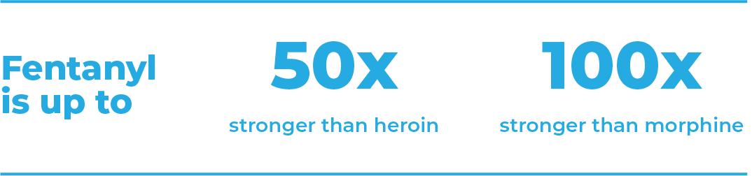
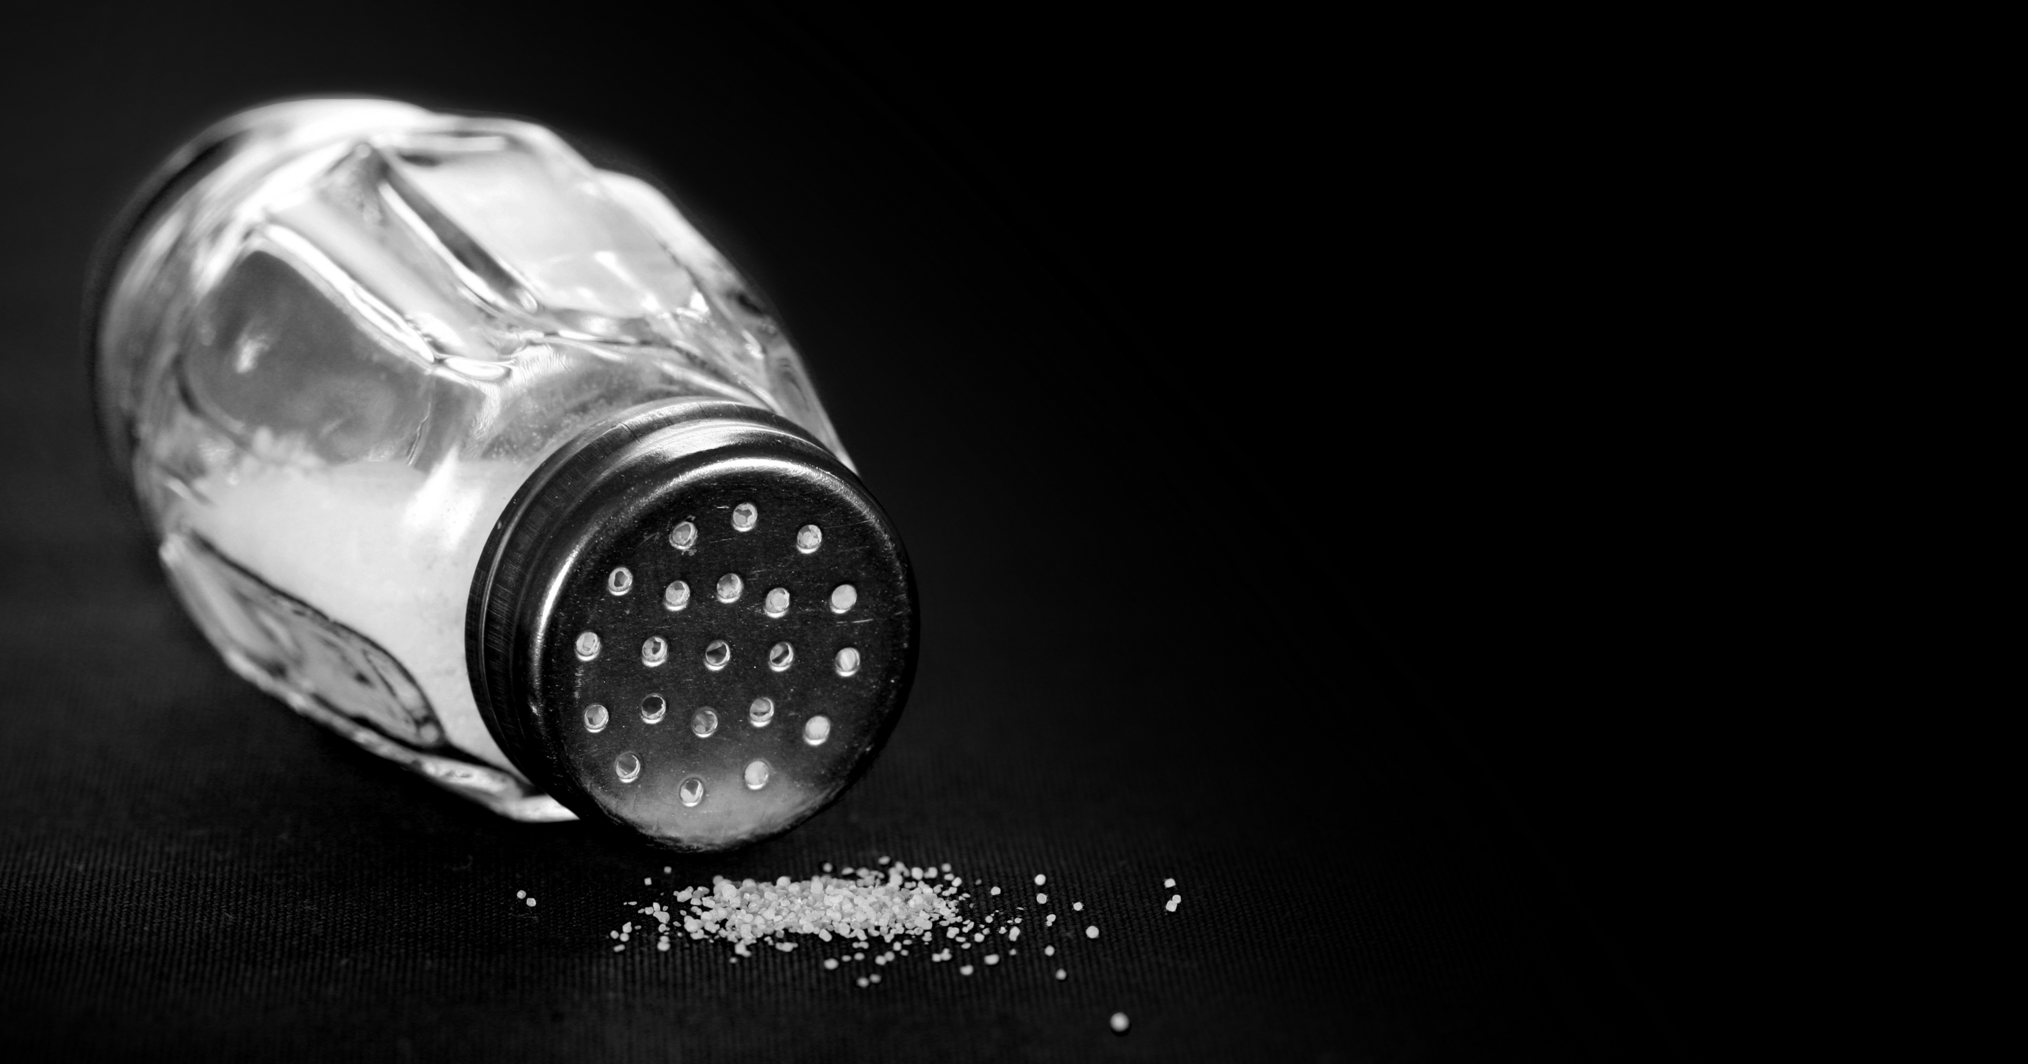
Fentanyl is different from other drugs.
Fentanyl is a potent synthetic opioid drug. When prescribed by a doctor, it’s used for pain relief in controlled doses.
It’s massively strong.
An amount as small as 2 grains of salt can cause an overdose.

Slide 5
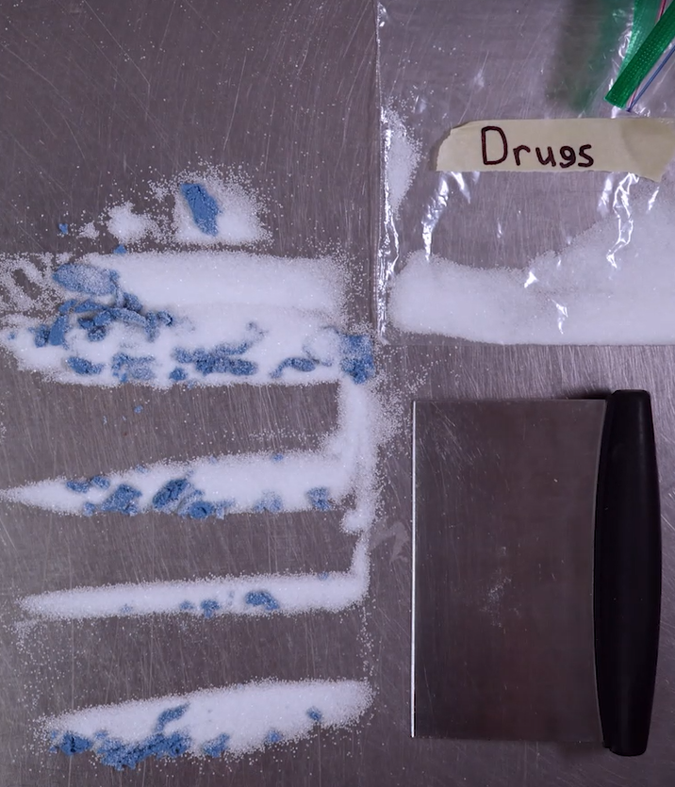
Fentanyl doesn’t mix well.
A pill or line may have no fentanyl but another from the same batch may have a dangerous amount. Fentanyl can be clumpy.
When people make or sell drugs and mix in fentanyl, it doesn’t spread evenly throughout the batch.
Less fentanyl
More fentanyl

Slide 6
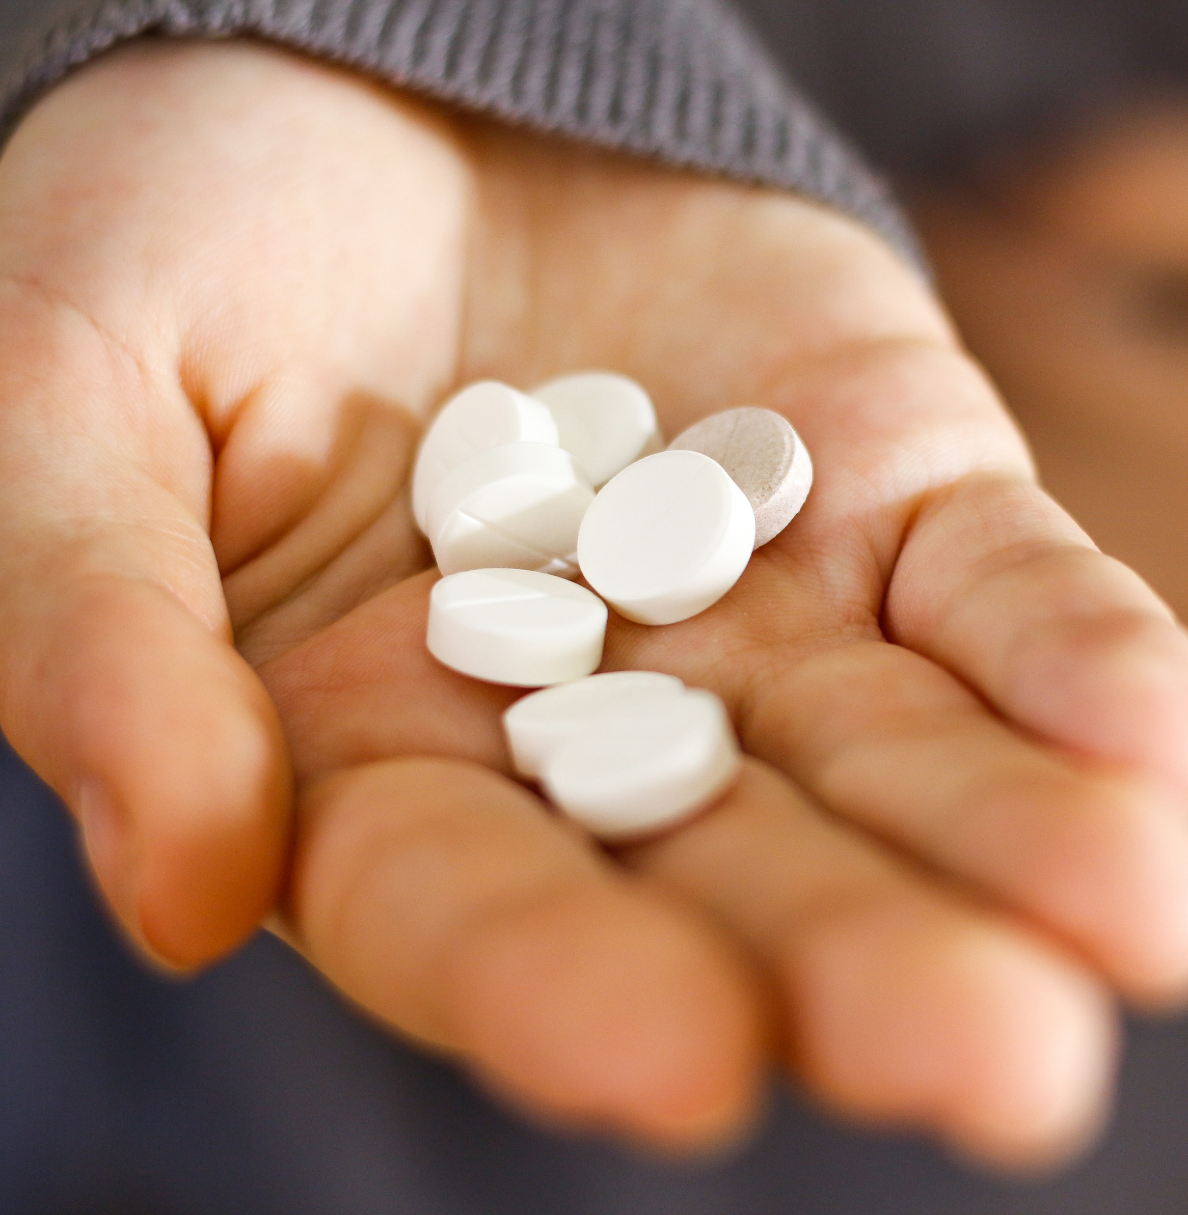
Fentanyl doesn’t always look the same.
You can’t taste it. You can’t smell it.
Fentanyl is often found in powder, pill, or liquid form.
It can be mixed into other drugs like pills, meth, cocaine or molly. People who make or sell drugs often mix it in to make the drug stronger at less cost to them.

Slide 7
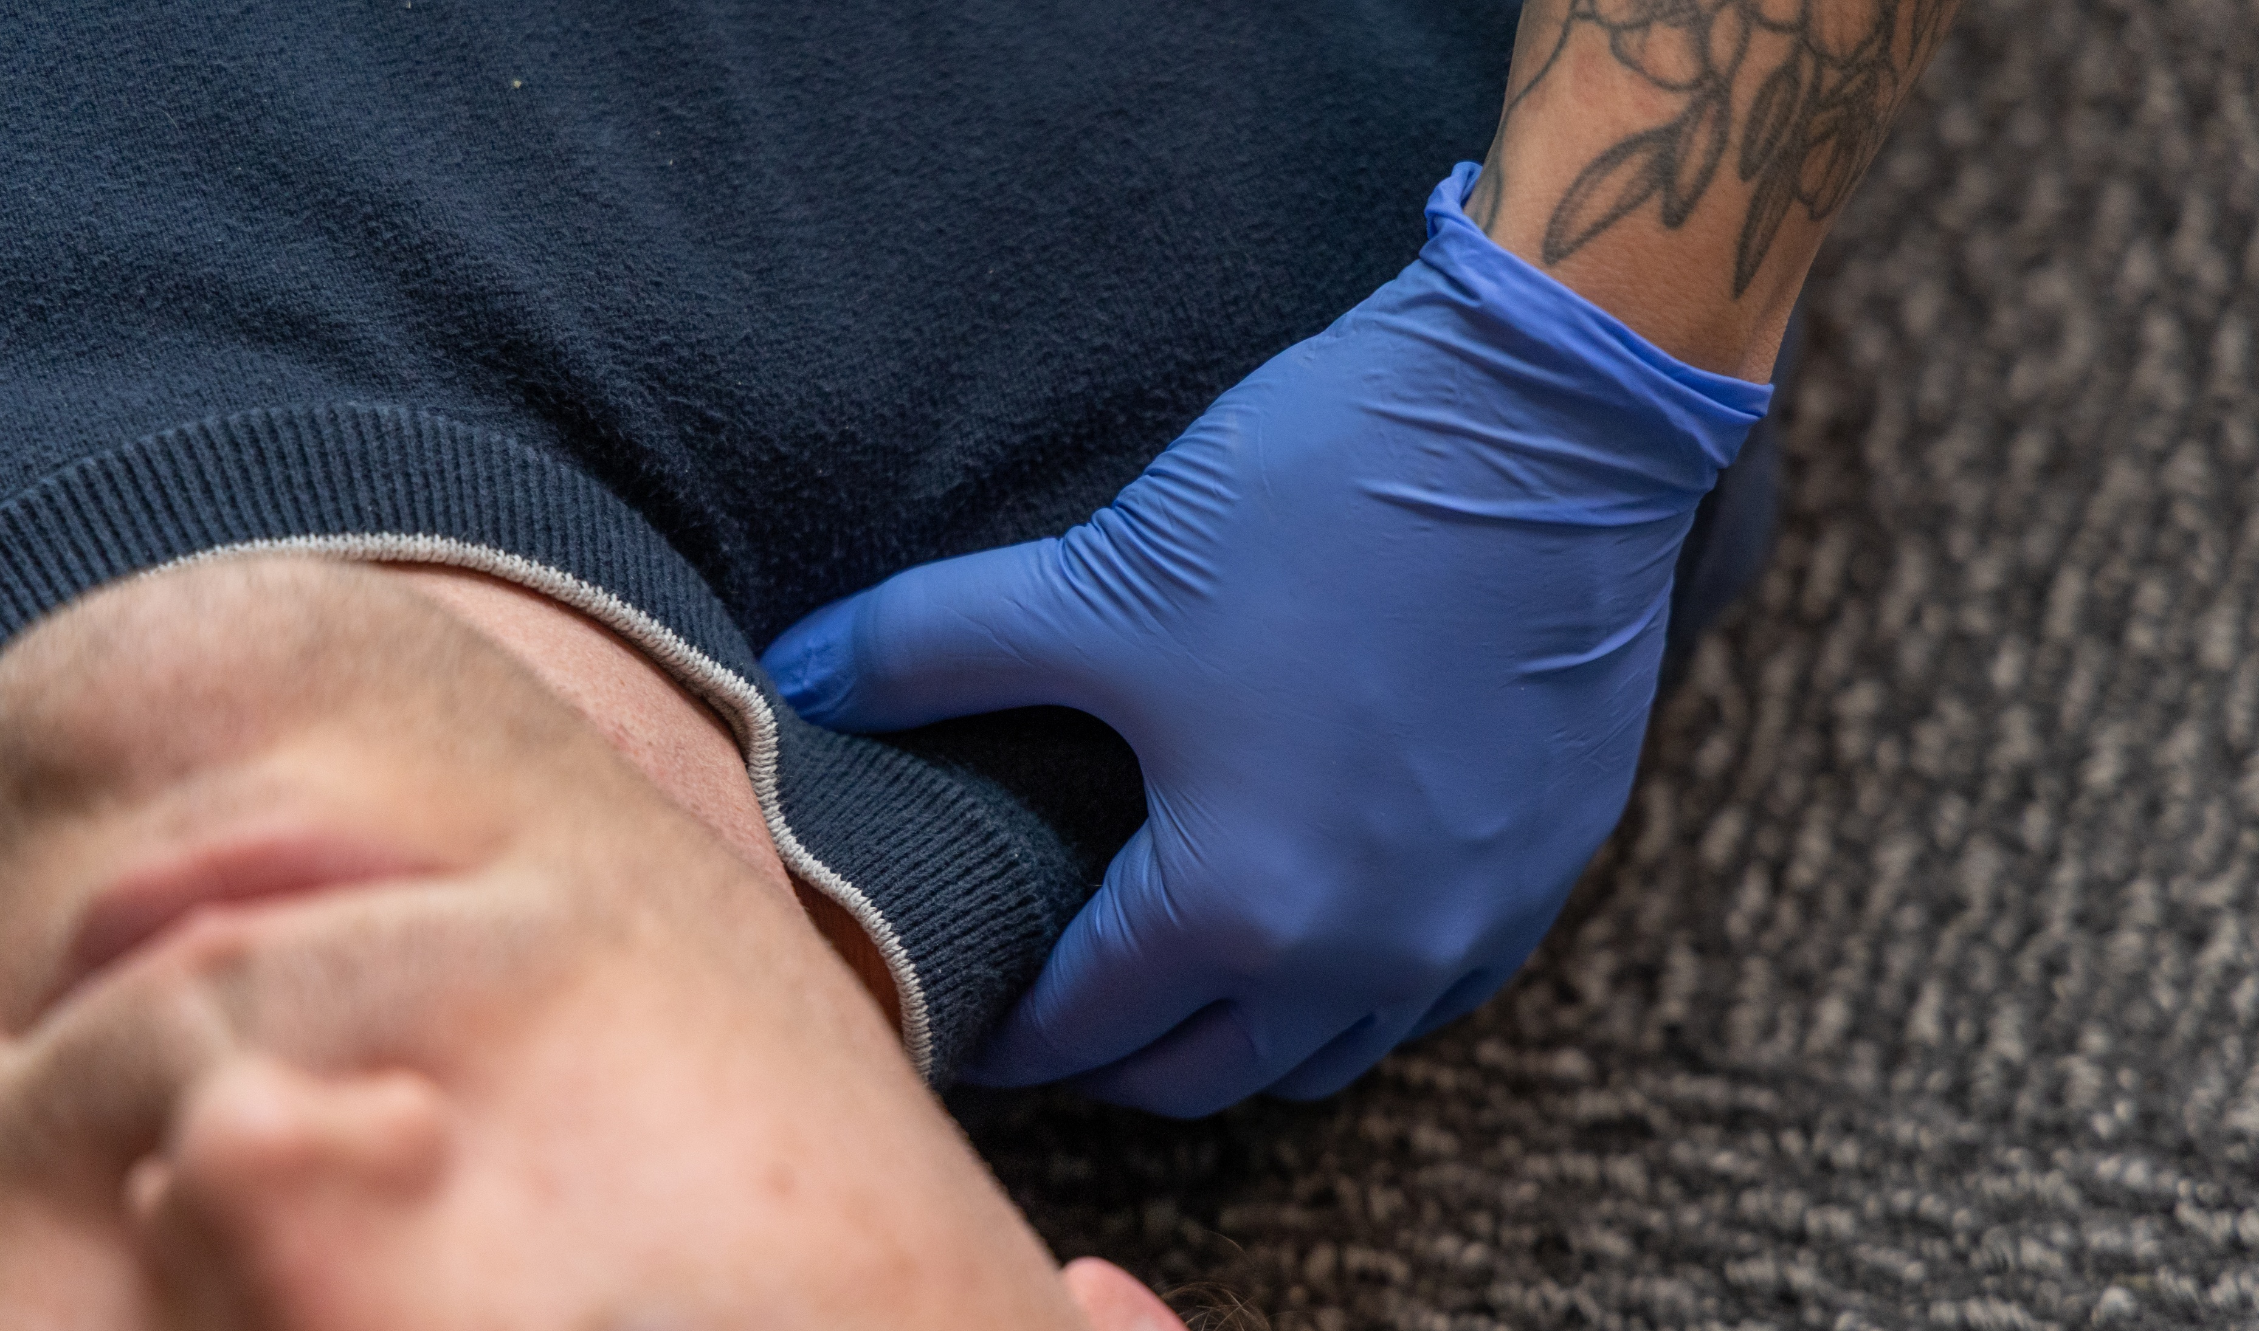
Recognize and Response to Overdose

Slide 8

Opioids in your community
68% of drug overdose deaths among Washington residents involved an opioid over the past 15 years (2007—2021).
Unintentional overdose can affect anyone because of contamination of other drugs.
Opioid overdose deaths increased across all demographics between 2019–2023.
You can save a life!

Slide 9
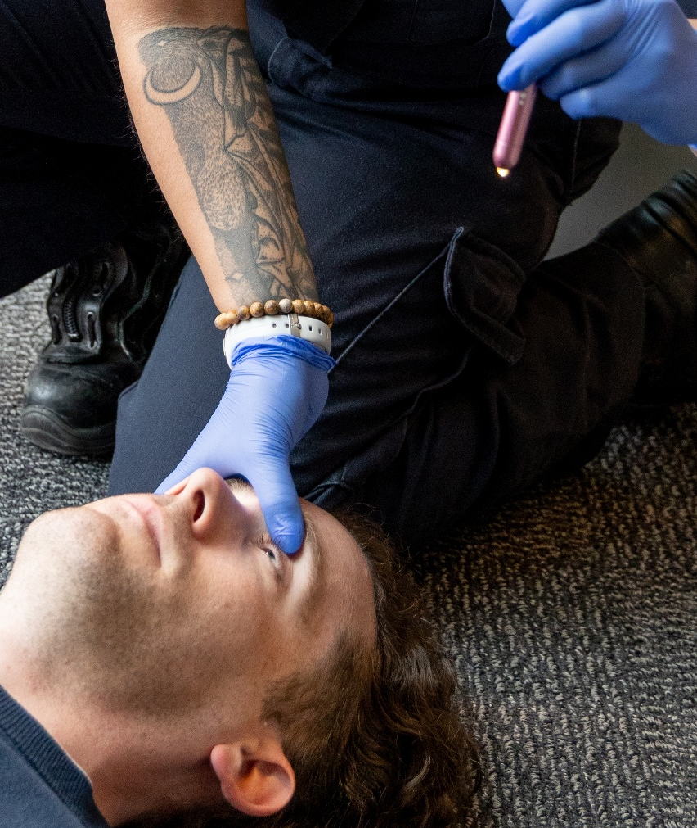
Signs of an opioid overdose
Unresponsive or very hard to wake.
Skin is blue or grey and cold.
Slow, shallow, or no breathing.
Gurgling or snoring-like sounds.
Constricted or pinpoint pupils.

Slide 10

How to respond to an opioid overdose
Call 911.
Administer naloxone.
Do rescue breathing, if trained.
Stay with the person. Wait for emergency responders.

Slide 11
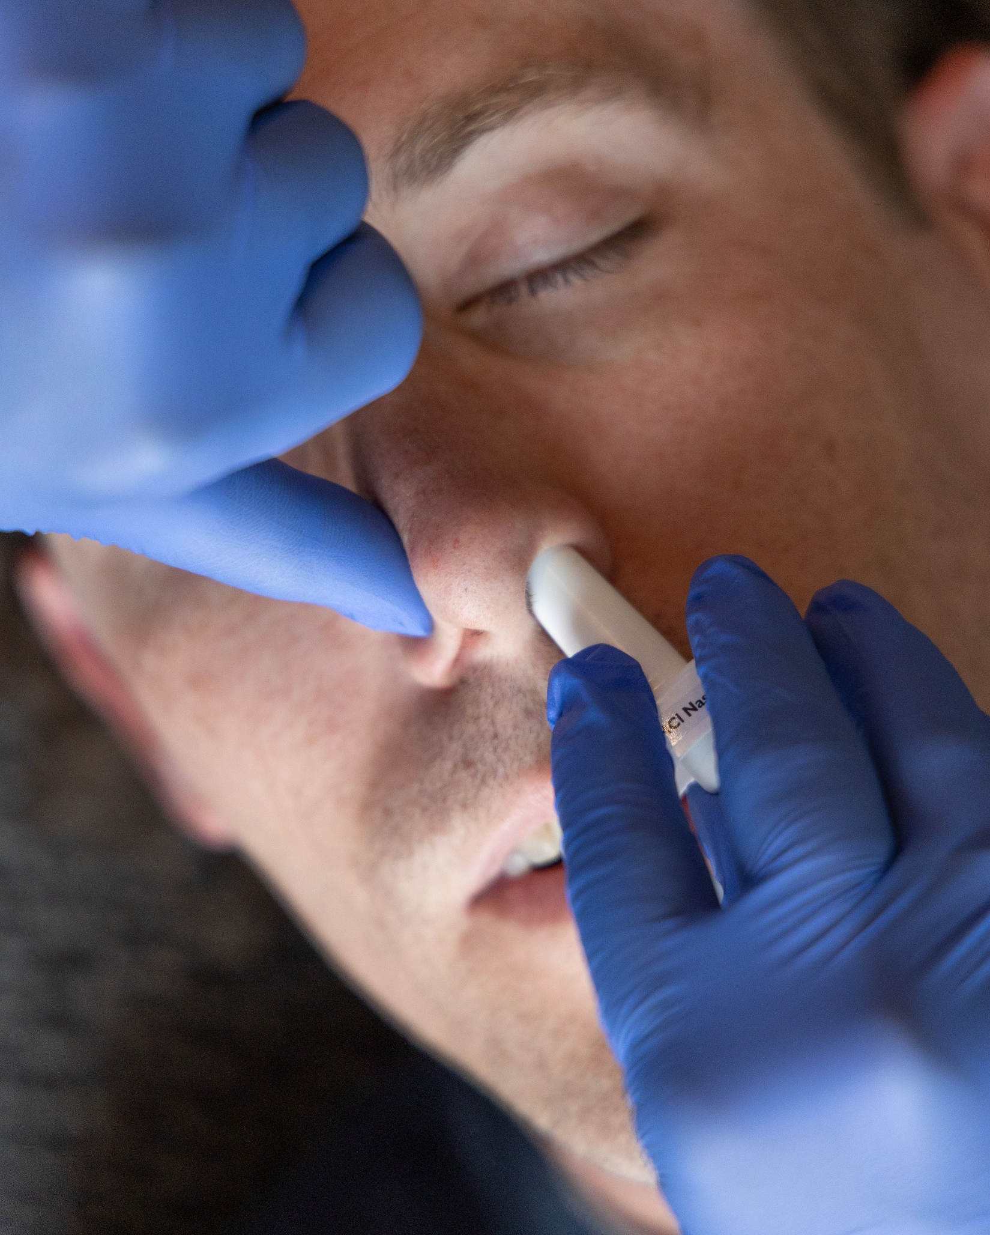
Administering naloxone
Administer naloxone as soon as possible. It’s safe to use even if they aren’t overdosing.
Peel off the wrapper, tilt their head back, place it in their nose and press to spray.
If they are still unresponsive after two to three minutes, use another dose in the other nostril.
Use multiple doses if you need to until emergency responders arrive.
Monitor them after administering naloxone.

Slide 12
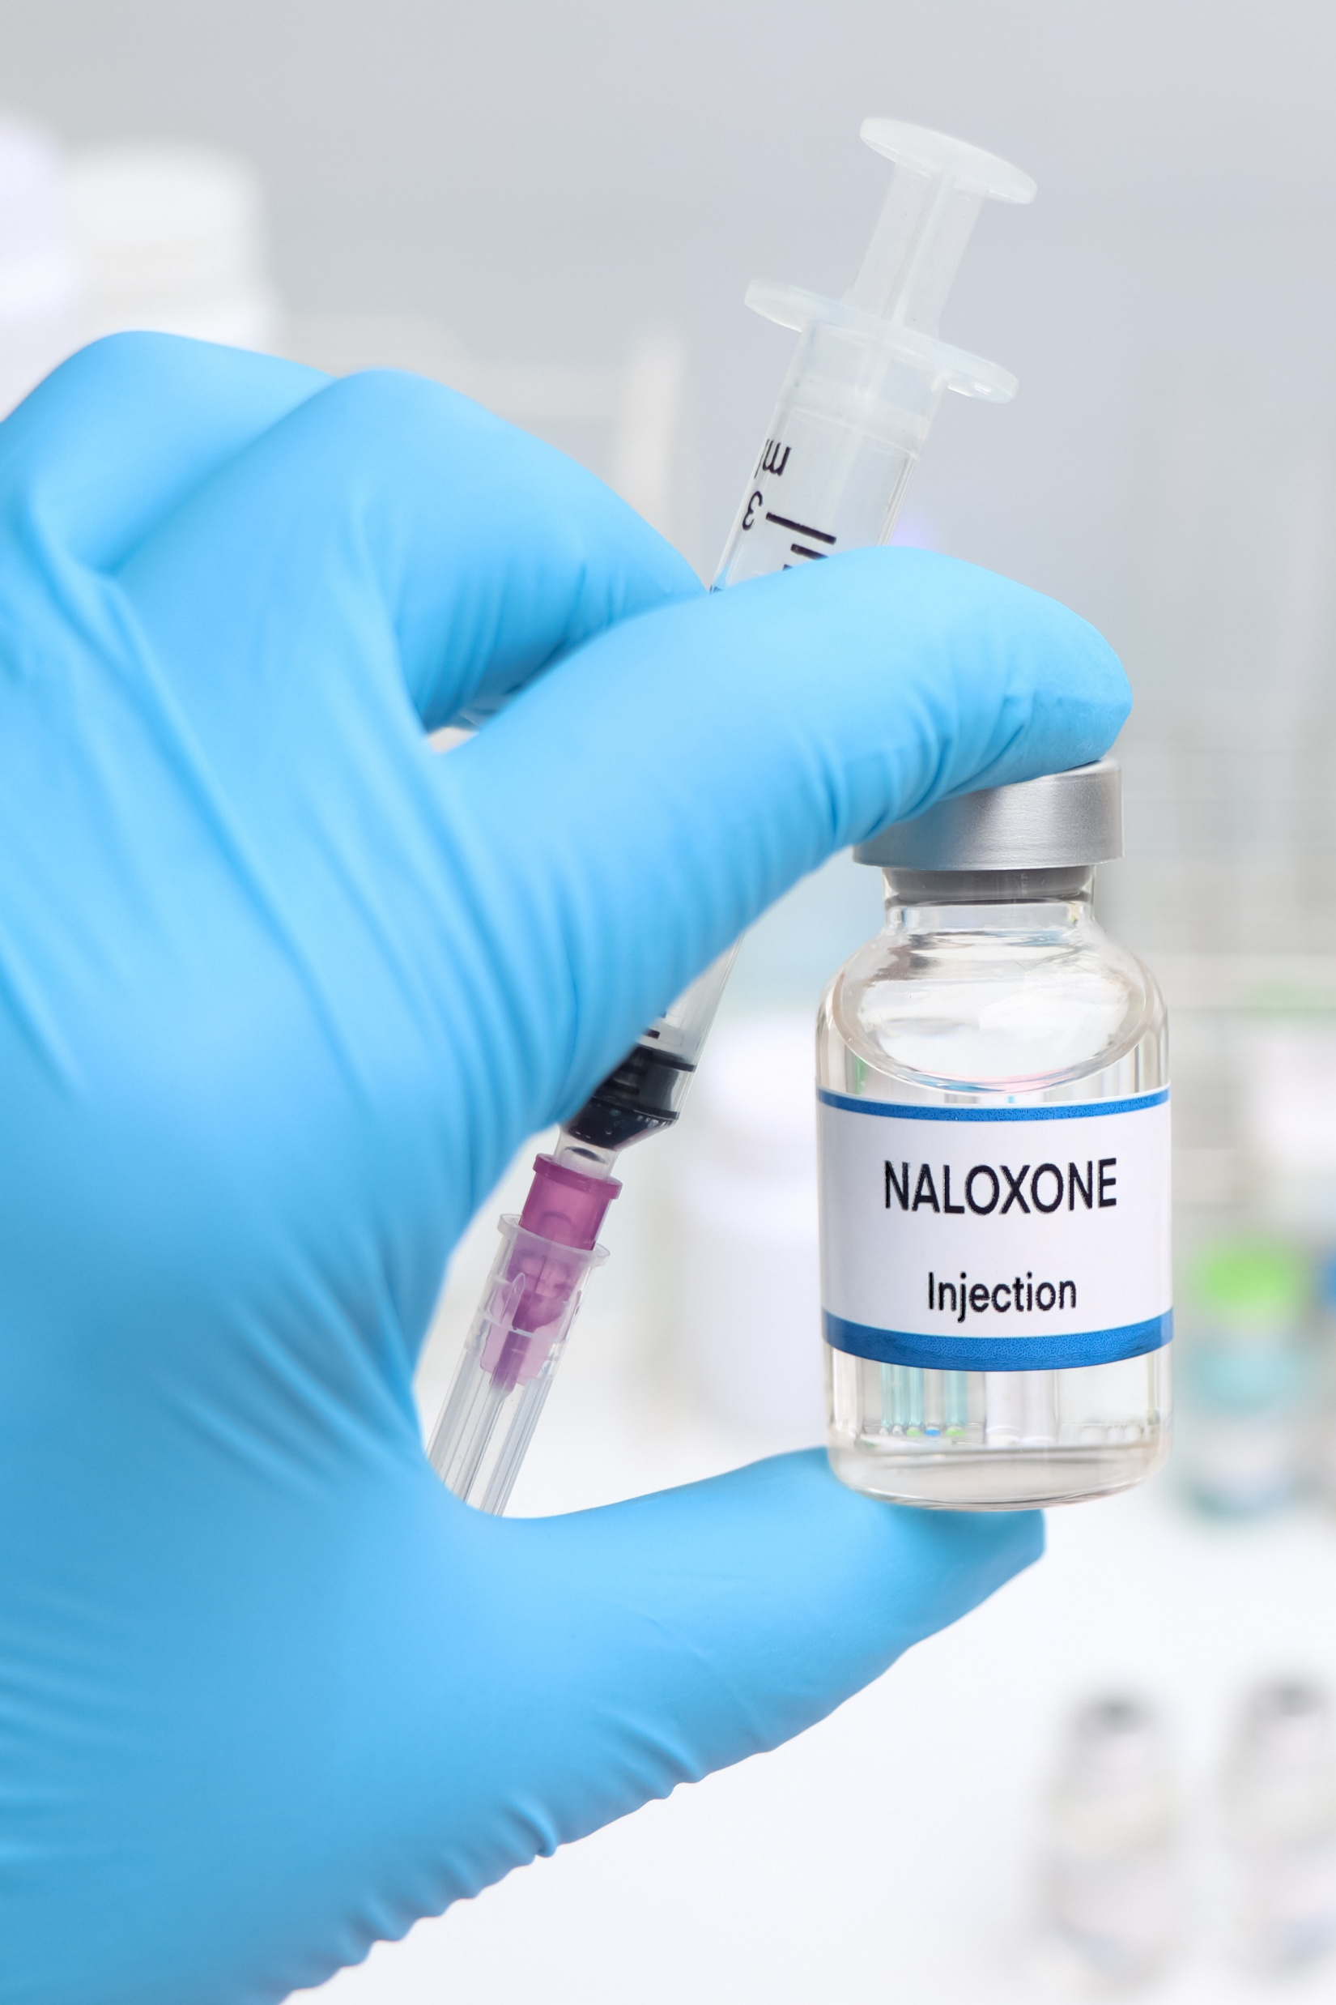
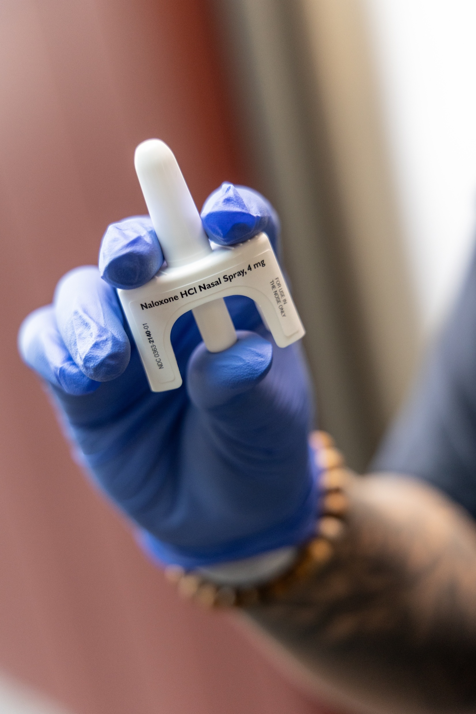
How naloxone works
Naloxone is an opioid overdose reversal drug. It’s safe and non-addictive.
Most commonly, it’s a nasal spray. You can also get it as injection.
It binds with opioids and blocks the effects on your system.
If there are no opioids present, it does nothing. You can’t overdose on naloxone, and people often need multiple doses.

Slide 13

Safety and Response Strategies

Slide 14
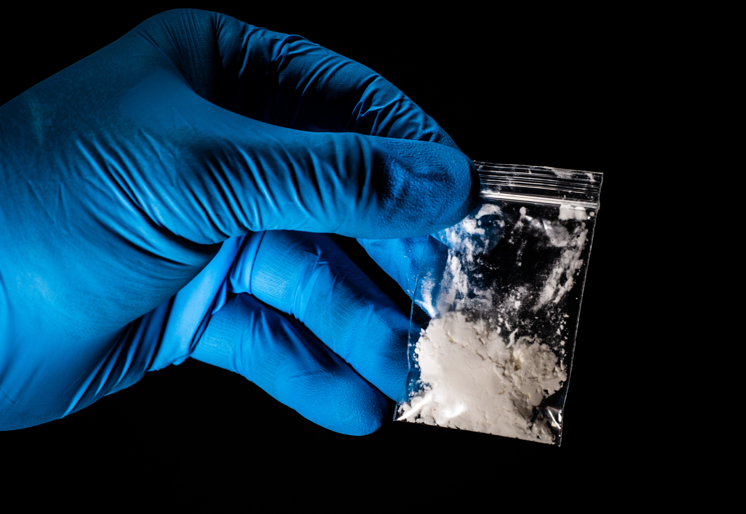
If you suspect a substance may contain fentanyl
Avoid actions that may cause powder to become airborne.
Assume nearby surfaces are contaminated, so your hands are.
Treat it like cayenne pepper. Don’t rub your eyes or scratch your skin.

Slide 15
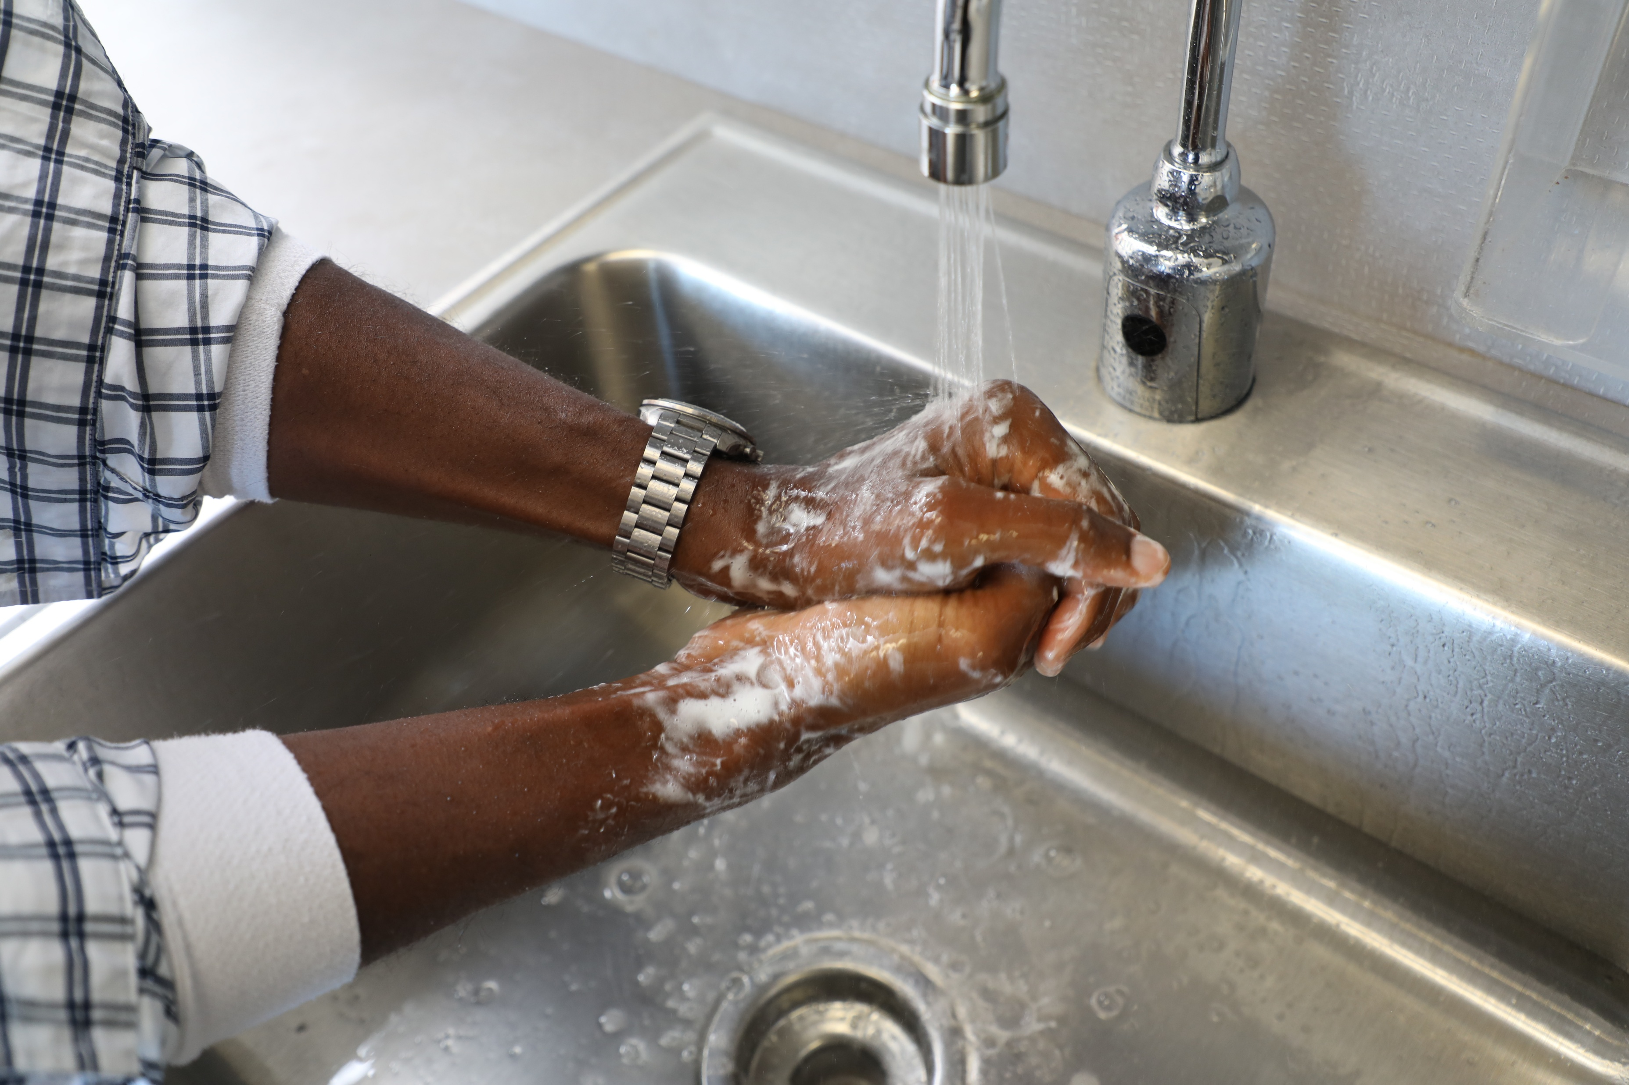
If you think you’ve been exposed to fentanyl
Don’t panic. Absorption through intact skin
is unlikely.
If you think you inhaled powder, move to fresh air and monitor for symptoms.
If you suspect your clothing is contaminated, carefully remove it. Place it in a sealed plastic bag to prevent further spread. Wash it separately from other items.
Wash your hands or any affected area with cool water and soap if available. Don’t use hand sanitizers as they can enhance absorption.

Slide 16
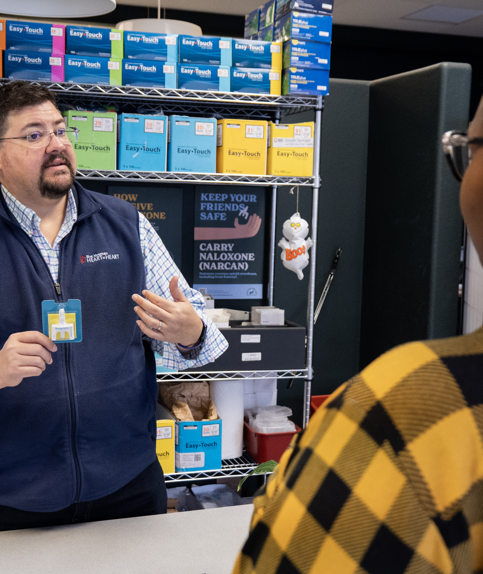
Your safety comes first.
Practical safety and prevention strategies for your organization:
Train your staff on naloxone.
Post overdose response protocols.
Build partnerships with local health departments and harm reduction groups.
Provide education on risks of counterfeit pills.
Promote stigma-free support and recovery resources.

Slide 17
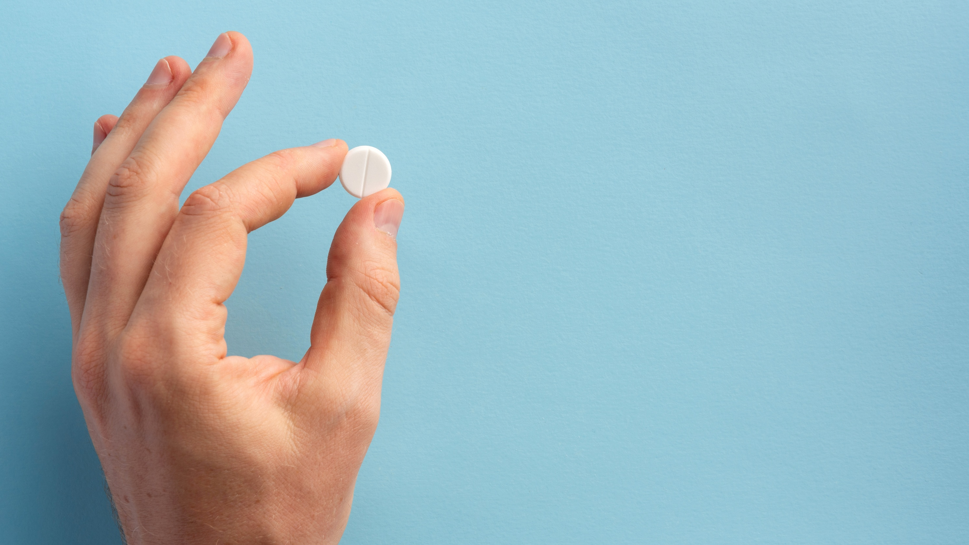
Common Concerns About Fentanyl & Naloxone

Slide 18

Myth #1 Skin exposure to fentanyl can cause an overdose.
Skin exposure to fentanyl poses little risk.
If you think you’ve been exposed to fentanyl, it’s a good idea to:
  Wash your hands.
  Avoid scratching yourself.

Slide 19

Myth #2 Just being near fentanyl powder can cause an overdose.
According to the Washington State Department of Health, fentanyl used in public spaces doesn’t create enough contamination on surfaces to cause people in the area to overdose.
If you see powder or a crushed pill, do not try to
clean it up yourself.
If you inhale fentanyl powder, you will have time
to act:
  Move to fresh air.
  Monitor your symptoms.
  Call for help.

Slide 20

Myth #3 Secondhand smoke from fentanyl can cause an overdose.
Accidental overdose from breathing in smoke from someone using fentanyl is highly unlikely.
Studies show that fentanyl smoked in public places like buses or trains does not release enough airborne particles to harm nearby people.
However, all types of smoke—including tobacco—can be harmful to your health.
If you're in a space where someone has smoked, improving ventilation (like opening windows and doors) can help reduce health risks.

Slide 21
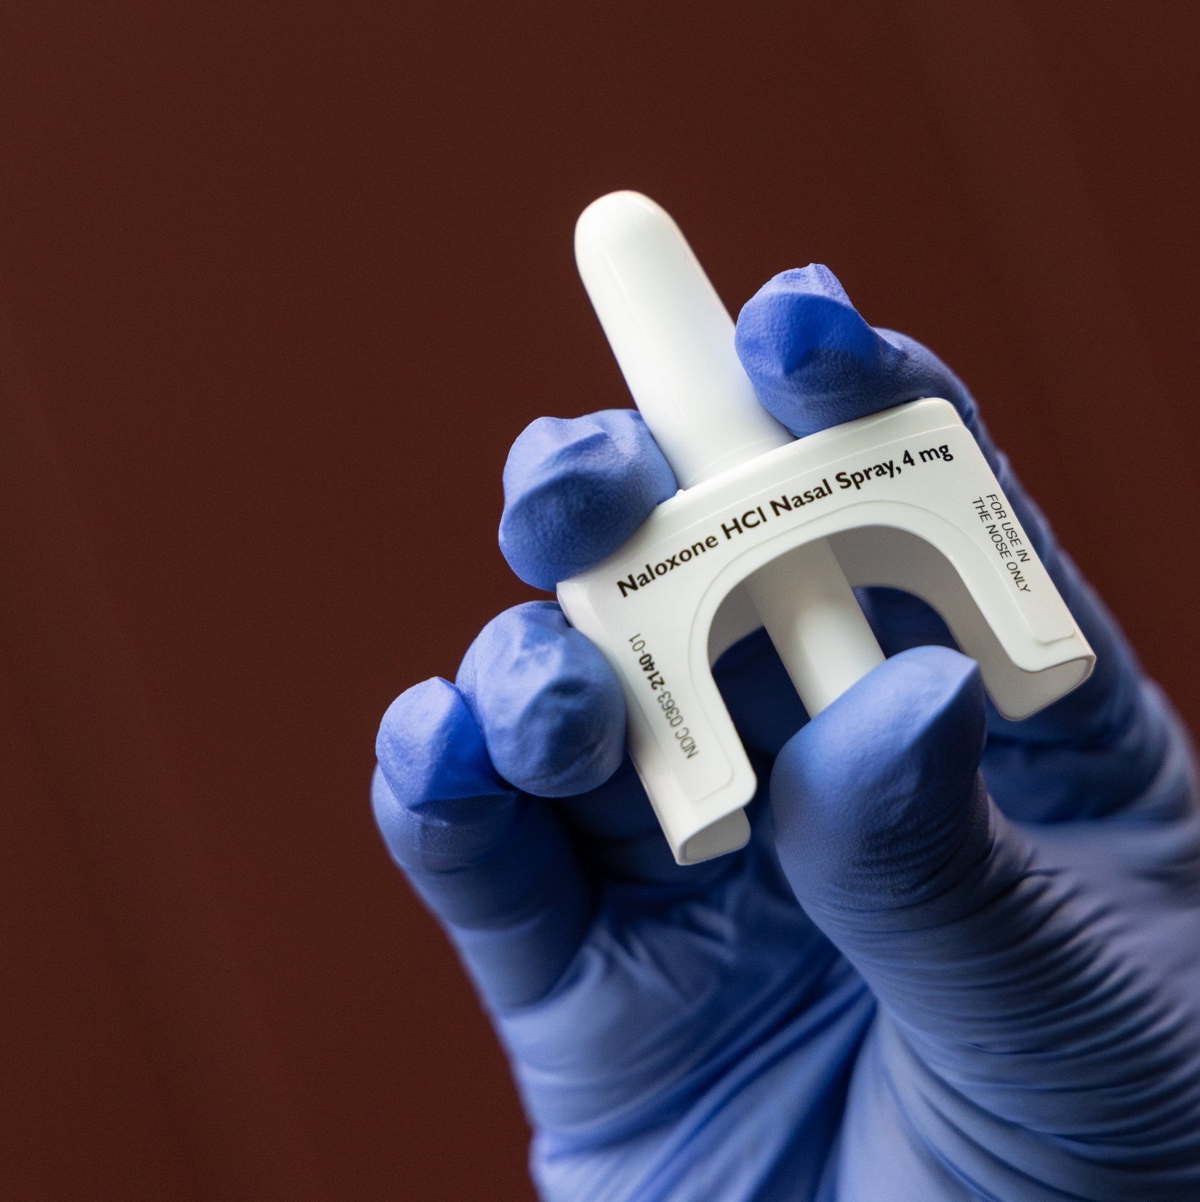
Myth #4 Naloxone can cause an overdose.
Naloxone is safe, so use it if you need it.
It binds with opioids and blocks the effects on your system.
If there are no opioids present, it does nothing.
You can’t overdose on naloxone, and people often need multiple doses.

Slide 22
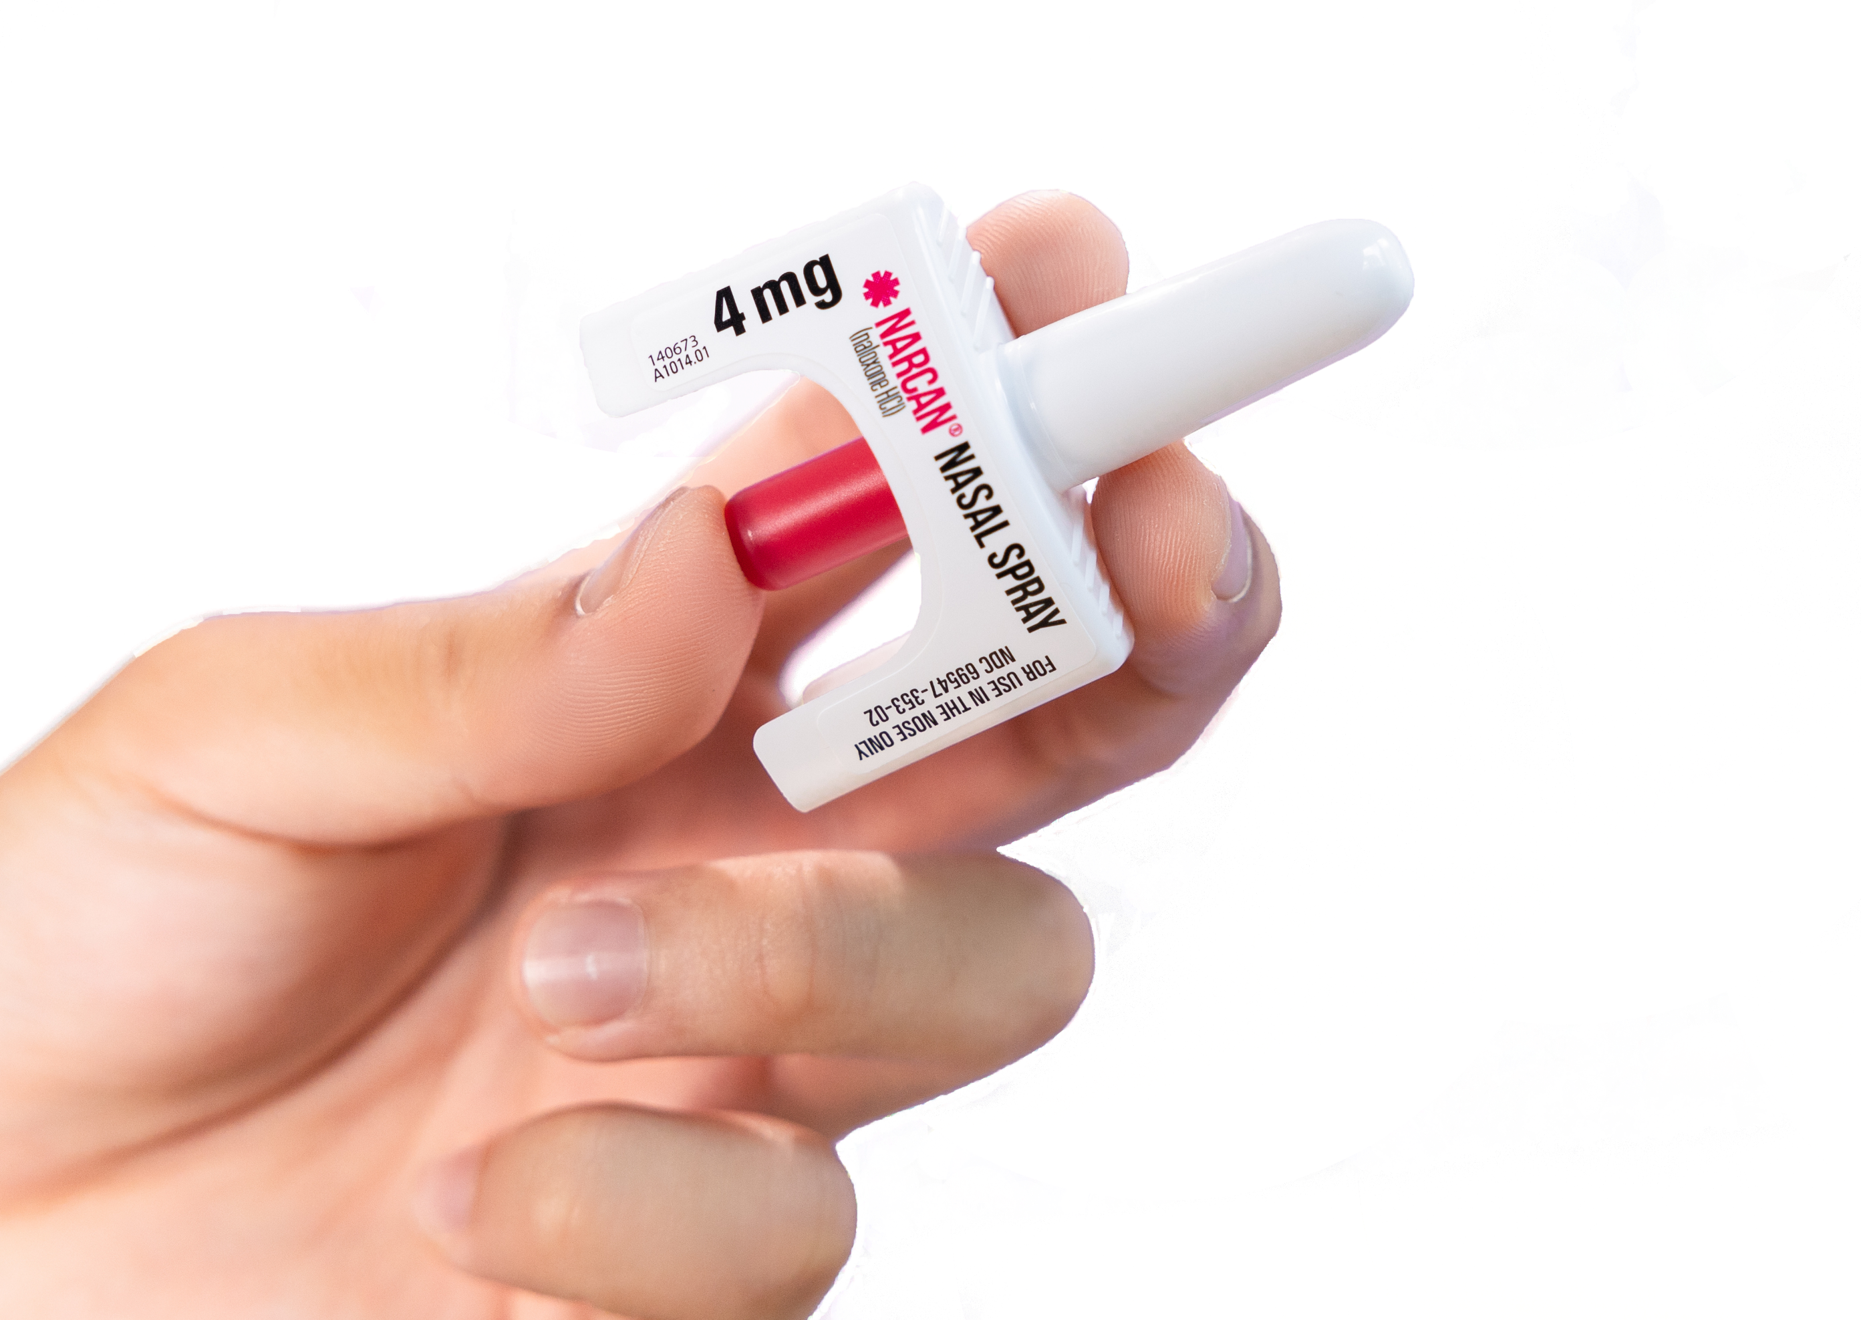
Key Takeaways

Slide 23
Be informed. Be prepared. Be safe.
Fentanyl is a strong opioid, different from other drugs.
Overdose is reversable. Respond quickly. Use naloxone.
Naloxone is safe, even if no opioids are present.
It’s safe to treat an overdose.
If you think you’ve been exposed to fentanyl, don’t panic.
Skin exposure or nearness to fentanyl poses little risk of overdose.
Implement practical safety and prevention strategies for your organization.

Slide 24
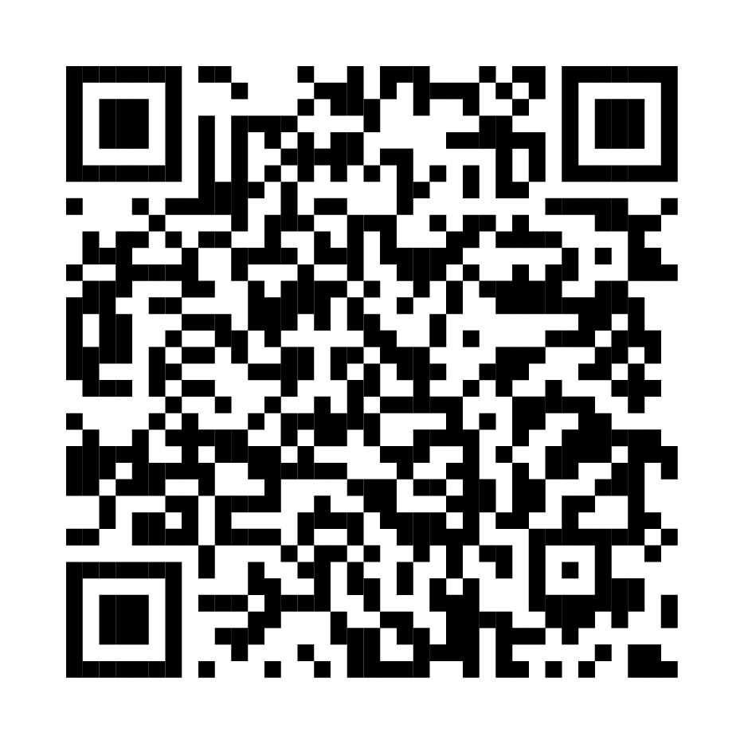
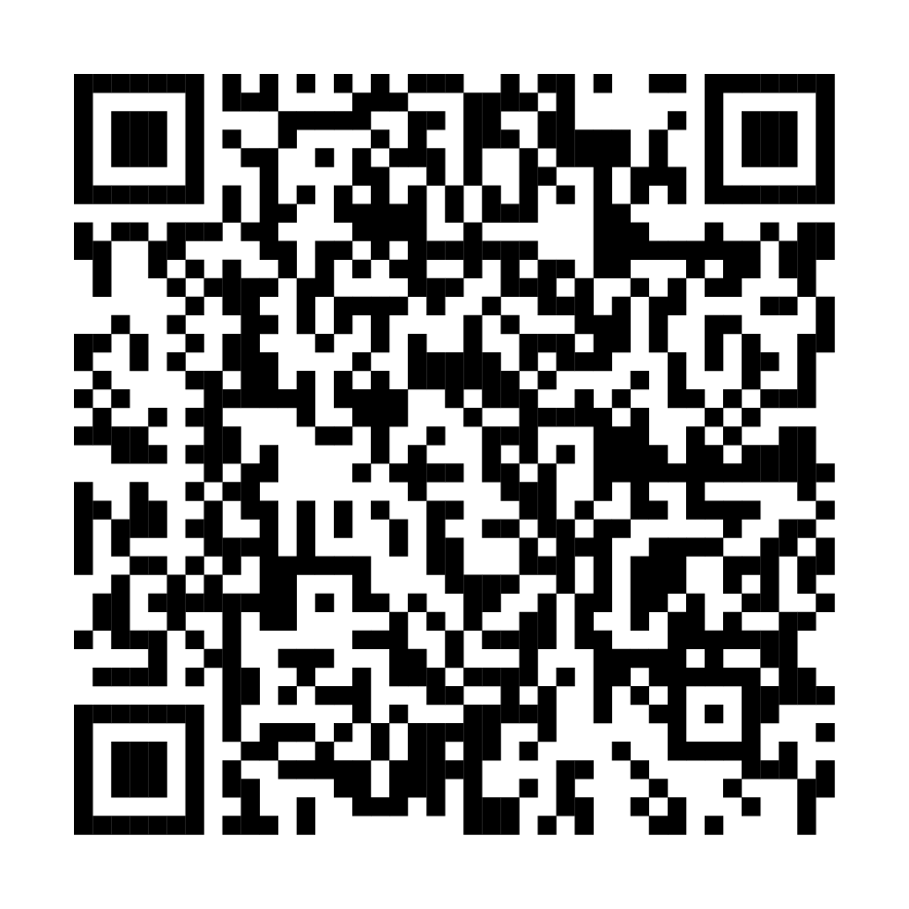
Resources
Find naloxone near you
Overdose education & naloxone distribution
You can get naloxone at most pharmacies without a prescription.
Most insurance covers the cost, or you may be able to get it free from a community organization.
Get helpful resources from Washington State Department of Health.
Get more great resources on fentanyl, overdose prevention, and treatment at fentanylfacts.org

