Slide 1
Fentanyl Awareness & Response
For First Responders

Slide 2
What you’ll learn
What fentanyl is.
Effective safety and response strategies.
Overdose response protocols.
Common concerns about fentanyl and naloxone.
Resources about opioids and naloxone.

Slide 3

Introduction to Fentanyl

Slide 4
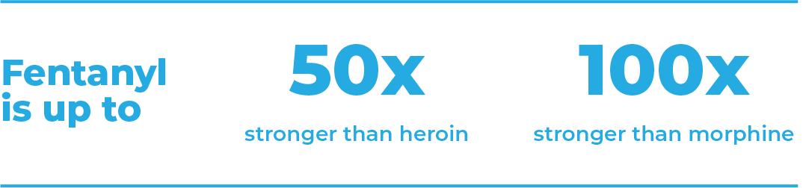

Fentanyl is different from other drugs.
Fentanyl is a potent synthetic opioid drug. When prescribed by a doctor, it’s used for pain relief in controlled doses.
It’s massively strong.
An amount as small as 2 grains of salt can cause an overdose.

Slide 5
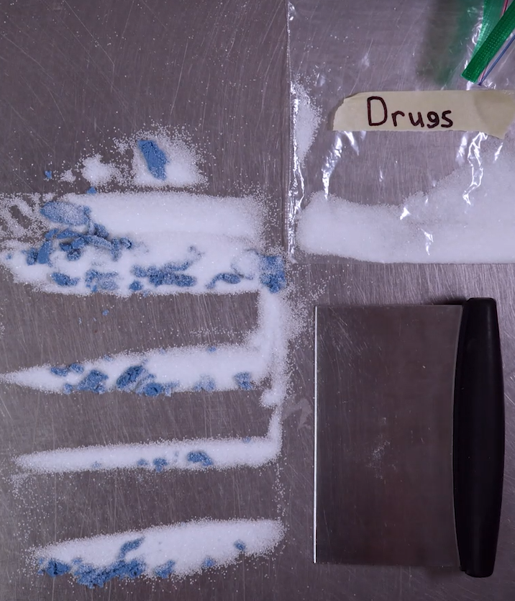
Fentanyl doesn’t mix well.
A pill or line may have no fentanyl but another from the same batch may have a dangerous amount. Fentanyl can be clumpy.
When people make or sell drugs and mix in fentanyl, it doesn’t spread evenly throughout the batch.
Less fentanyl
More fentanyl

Slide 6
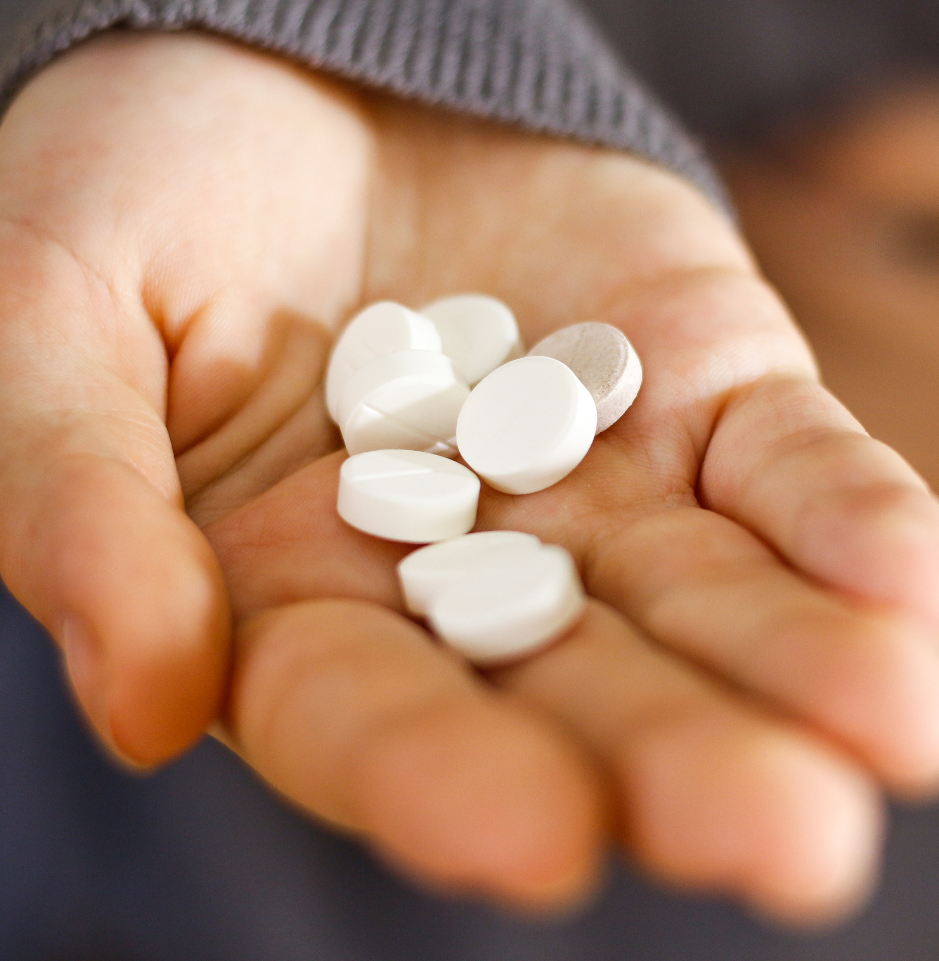
Fentanyl doesn’t always look the same.
You can’t taste it. You can’t smell it.
Fentanyl is often found in powder, pill, or liquid form.
It can be mixed into other drugs like pills, meth, cocaine or molly. People who make or sell drugs often mix it in to make the drug stronger at less cost to them.

Slide 7
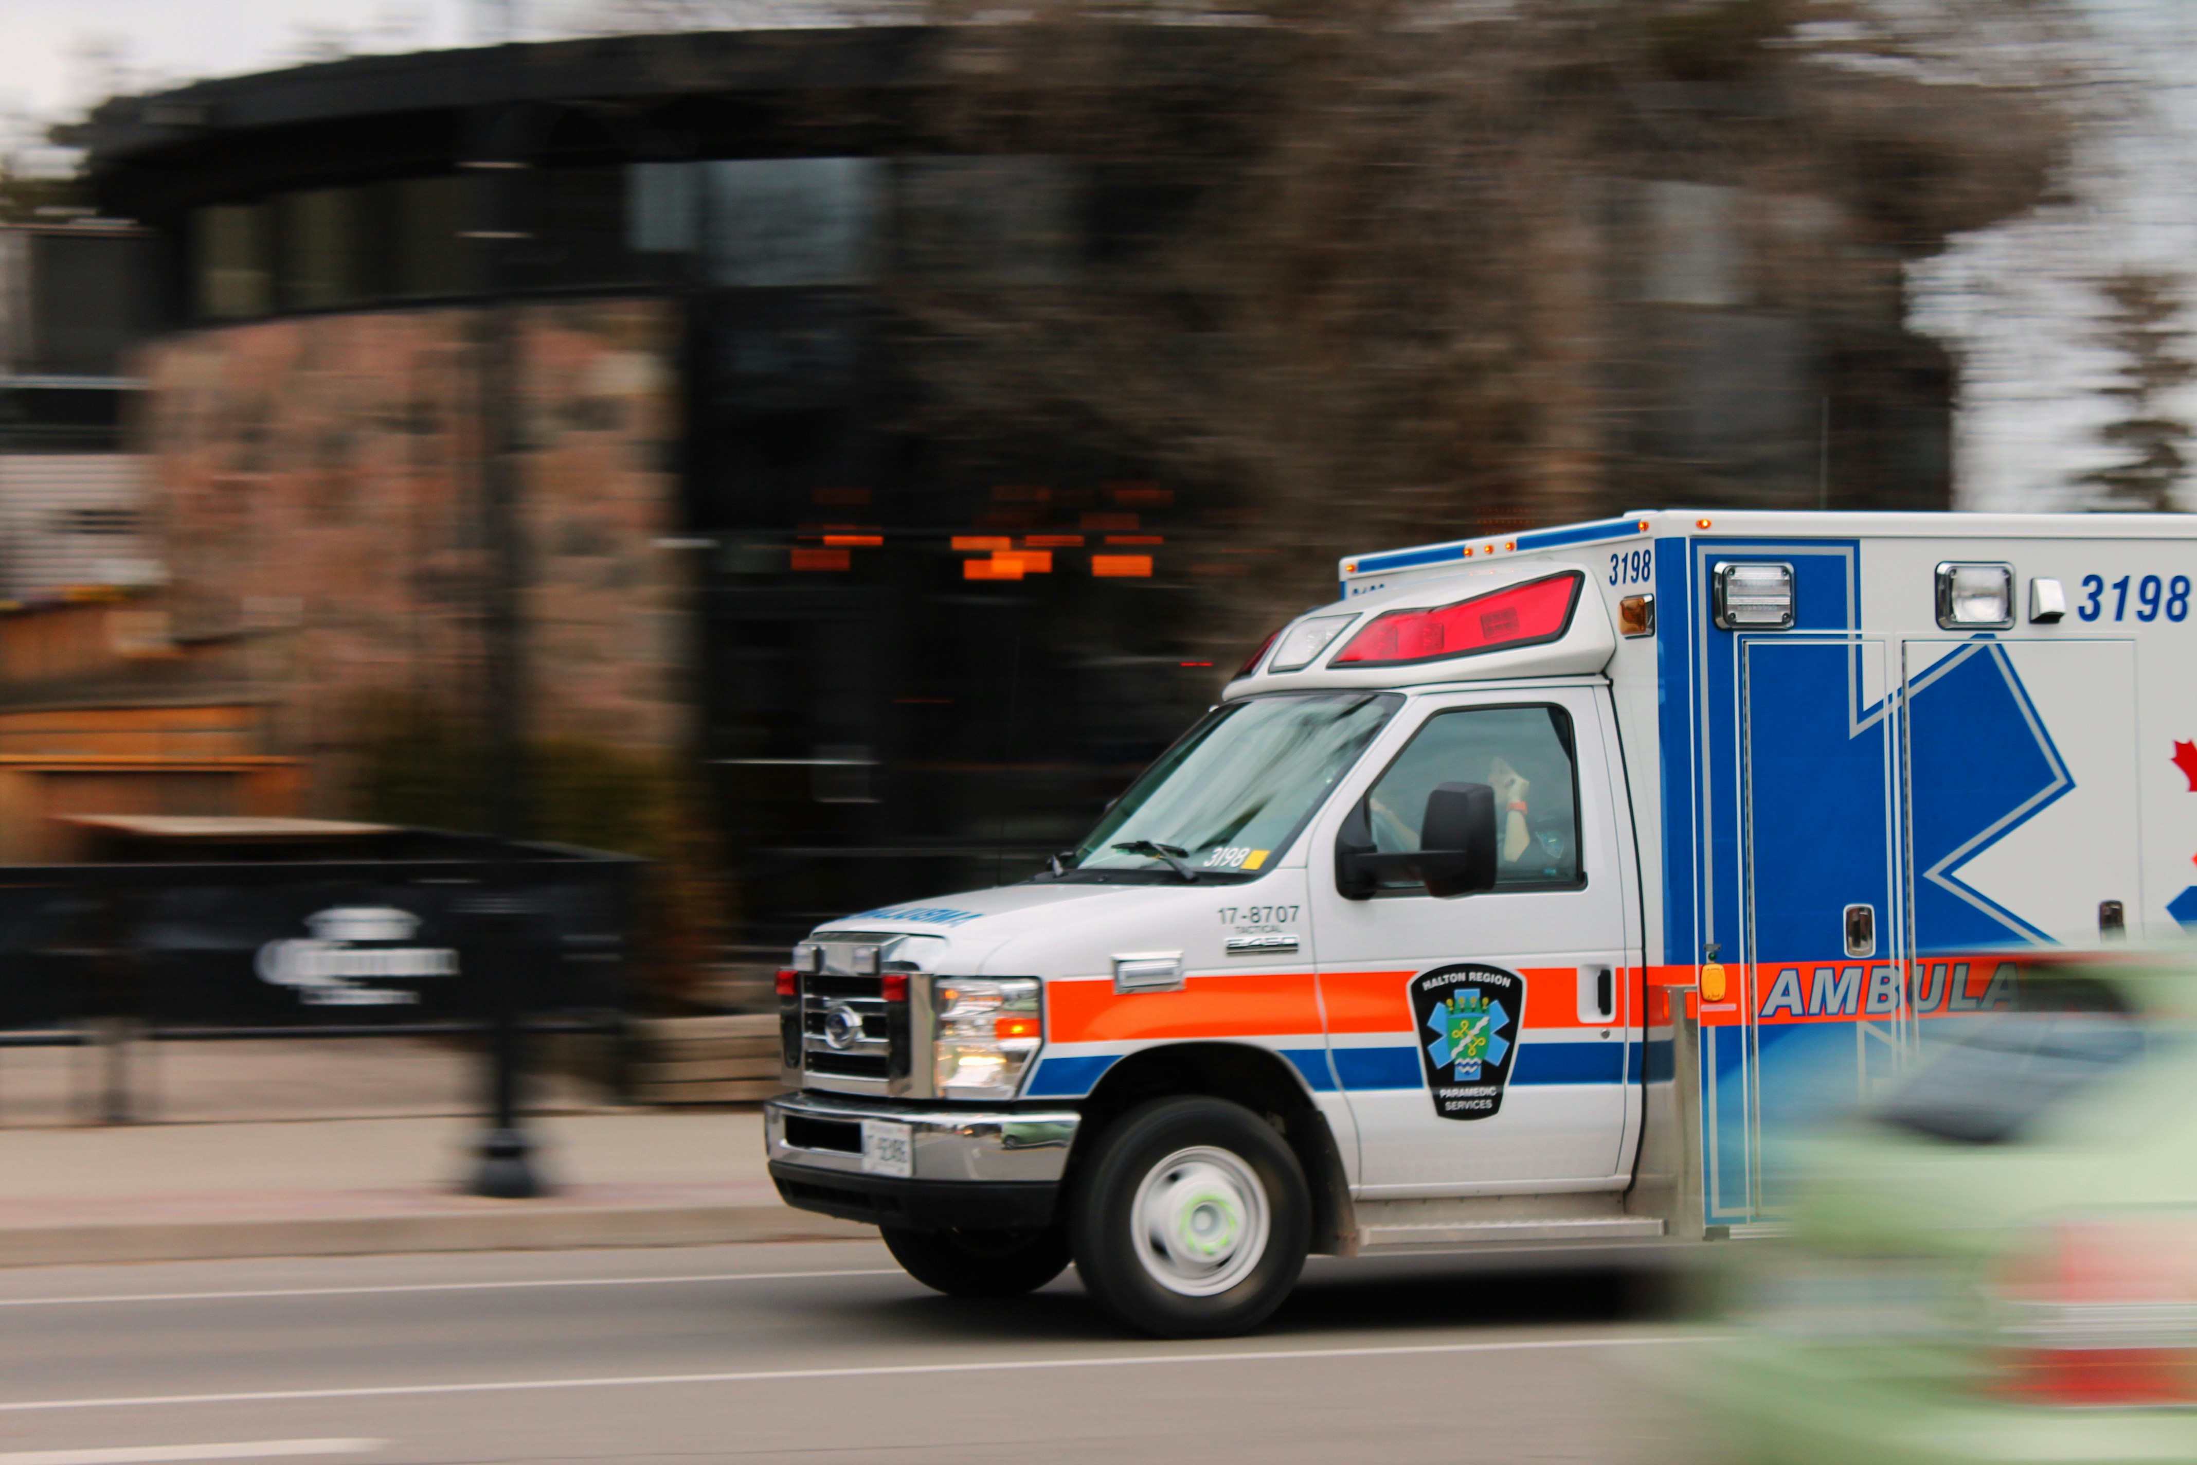
Safety Precautions for First Responders

Slide 8

Your safety comes first.
Wear proper Personal Protective Equipment (PPE) to help prevent accidental exposure.
Use nitrile gloves, an N95 mask, and safety glasses when handling unknown substances.
Refer to your agency’s guidelines for when and how to use PPE effectively.

Slide 9
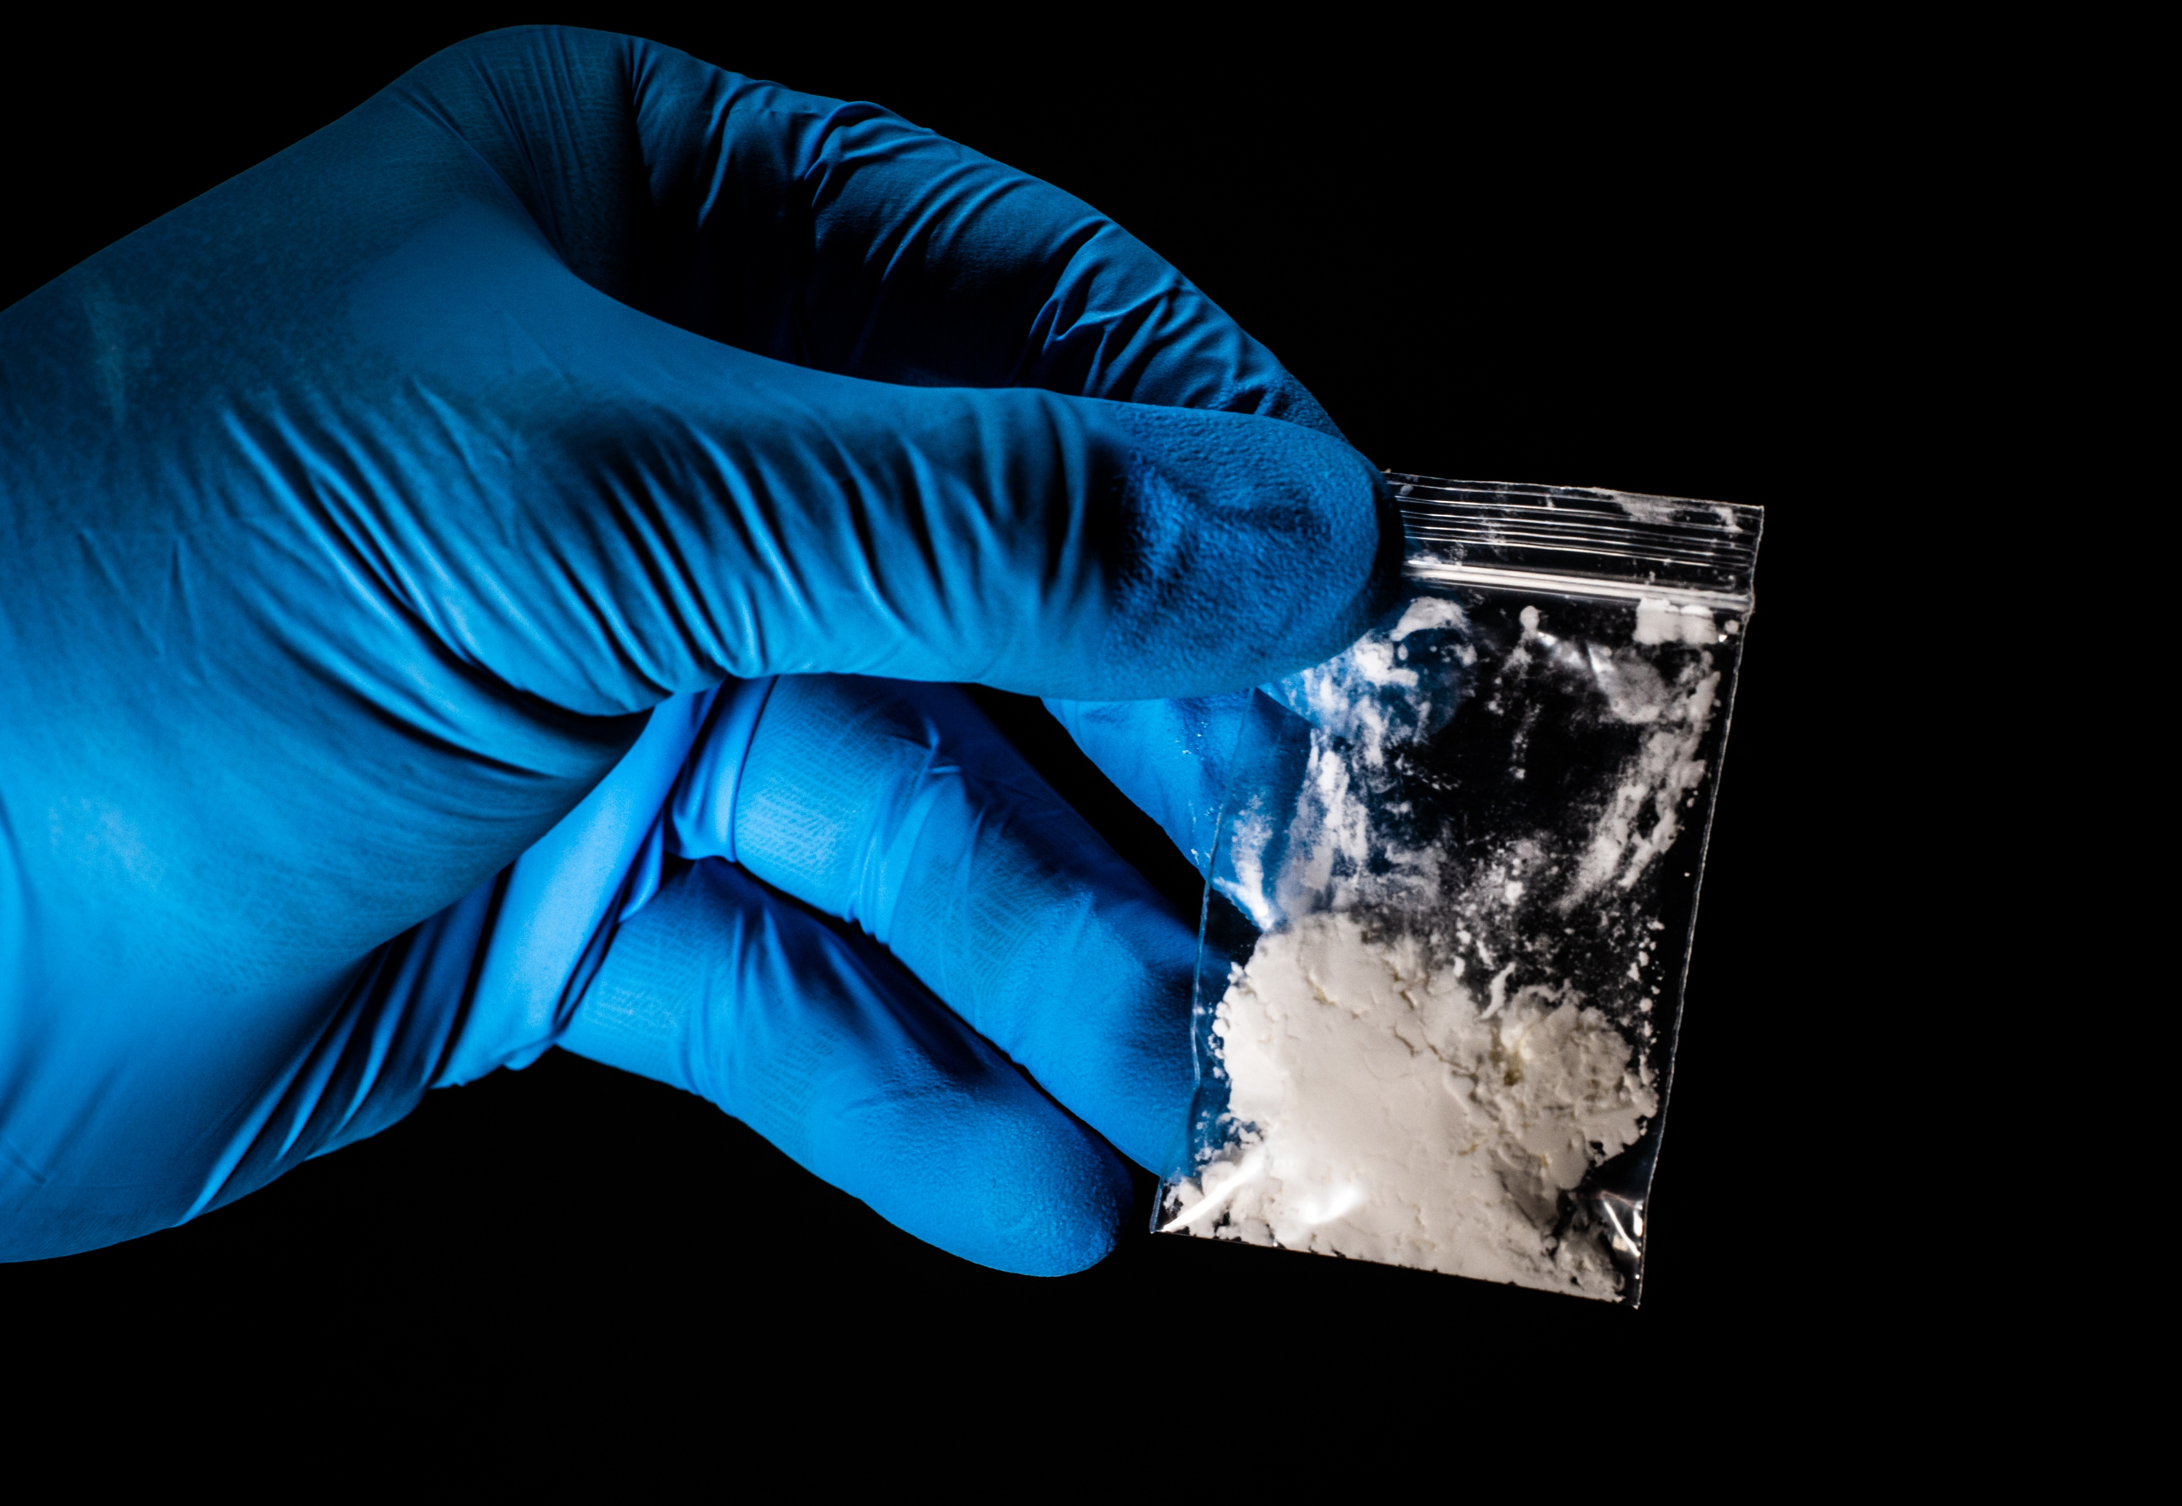
If you suspect a substance may contain fentanyl
Avoid actions that may cause powder to become airborne.
Assume nearby surfaces are contaminated, so your hands are.
Treat it like cayenne pepper. Don’t rub your eyes or scratch your skin.

Slide 10
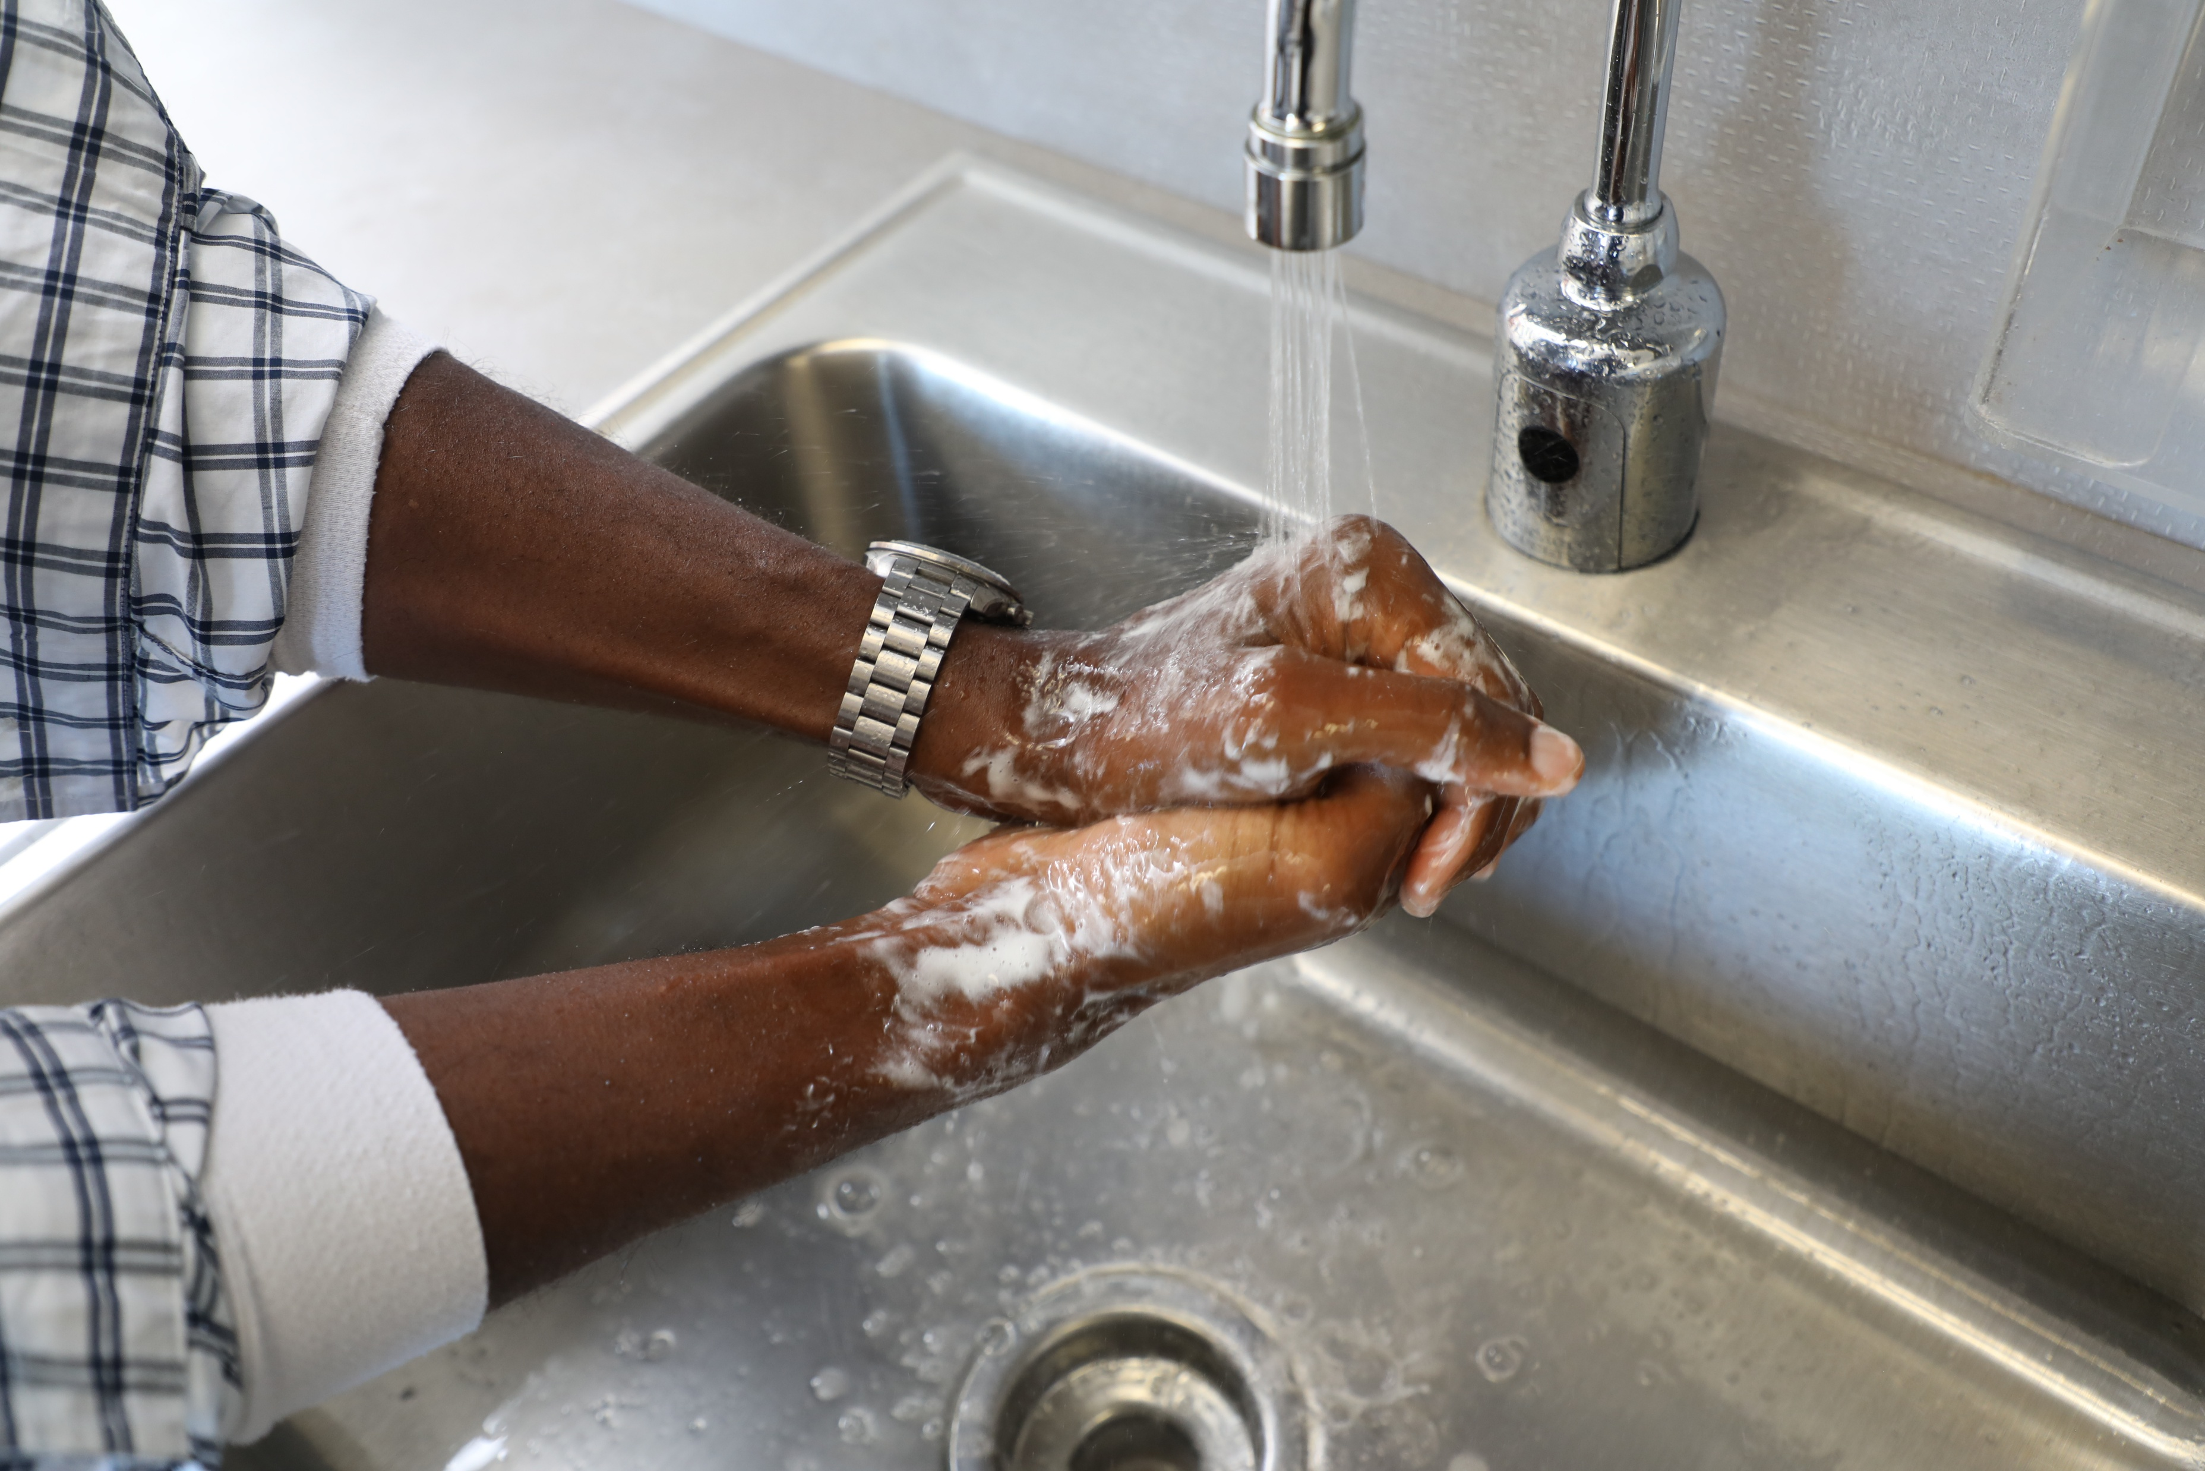
If you think you’ve been exposed to fentanyl
Don’t panic. Absorption through intact skin is unlikely.
Wash your hands or any affected area with cool water and soap if available. Don’t use hand sanitizers as they can enhance absorption.
If you think you inhaled powder, move to fresh air and monitor for symptoms.
If you suspect your clothing is contaminated, follow your department’s guidelines.

Slide 11
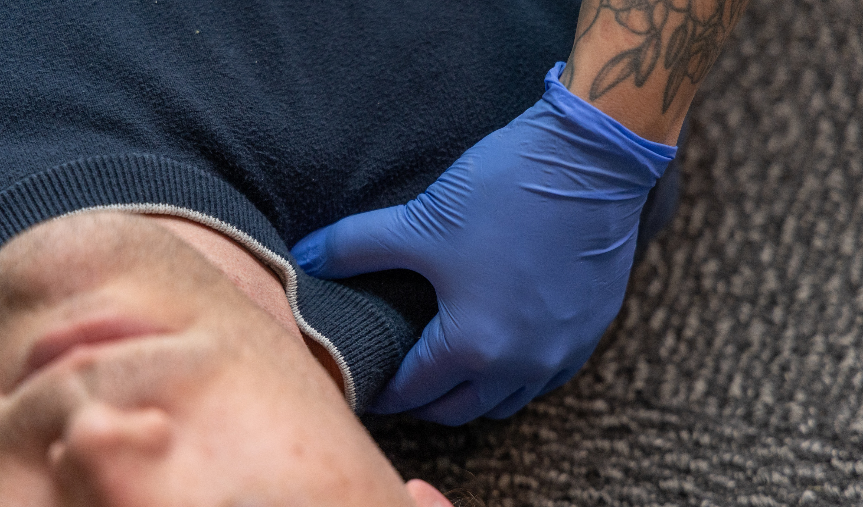
Overdose Response Protocols

Slide 12
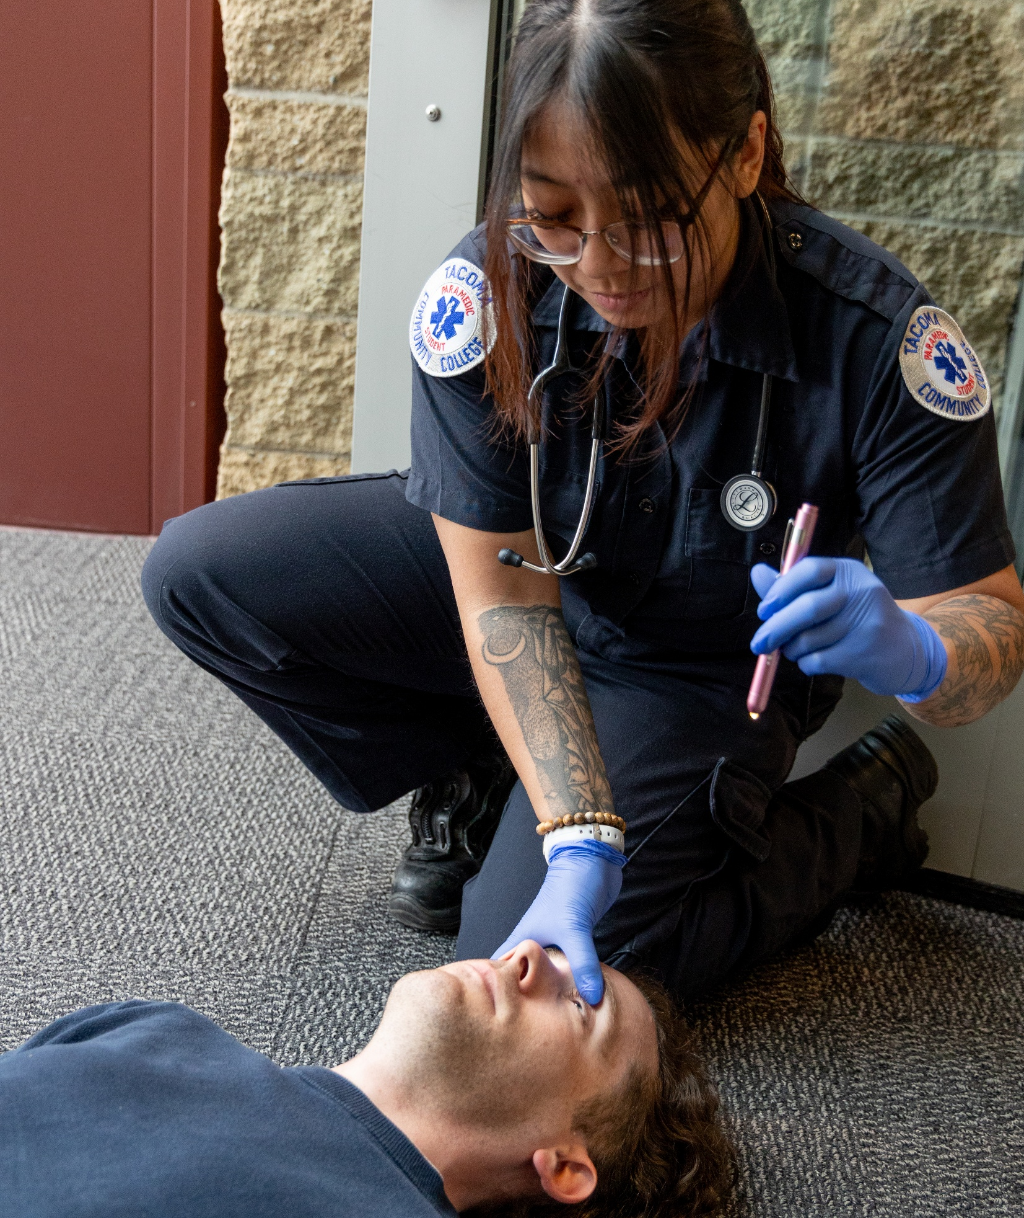
Signs of an opioid overdose
If someone is unresponsive, their skin is blue or grey and cold, and they’re not breathing normally.
If ANYONE shows symptoms of slow breathing, unresponsiveness and constricted or pinpoint pupils, administer naloxone, also called Narcan.

Slide 13
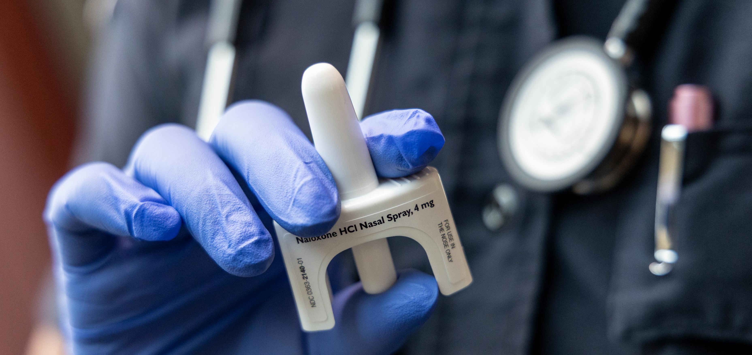
How naloxone works
It binds with opioids and blocks the effects on your system.
If there are no opioids present, it does nothing. You can’t overdose on naloxone, and people often need multiple doses.

Slide 14
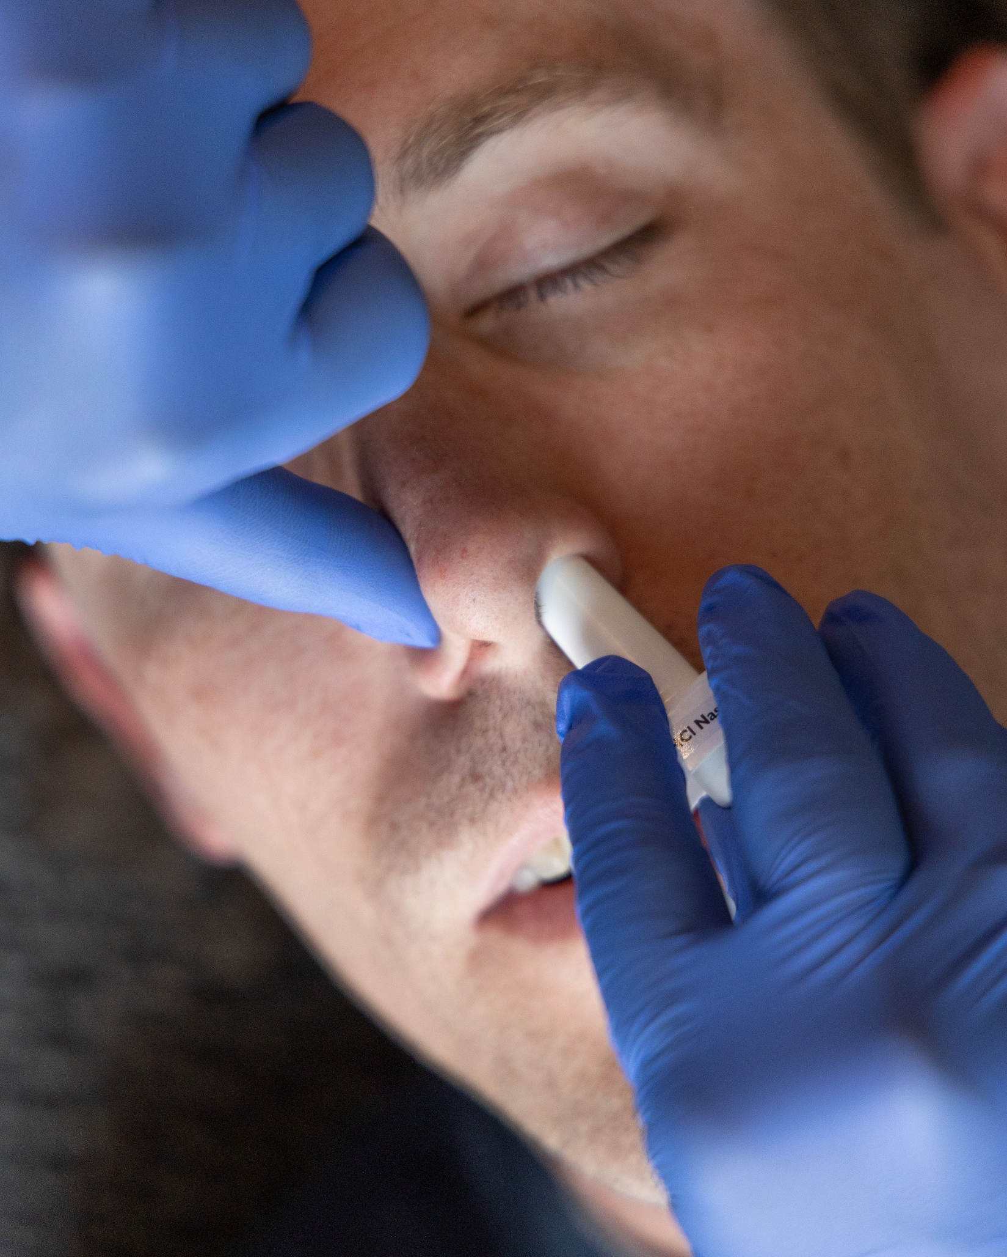
Administering naloxone
Administer naloxone as soon as possible. It’s safe to use even if they aren’t overdosing.
Peel off the wrapper, tilt their head back, place it in their nose and press to spray.
If they are still unresponsive after two to three minutes, use another dose in the other nostril.
Use multiple doses if you need to until paramedics arrive.
Monitor the patient after administering naloxone.

Slide 15
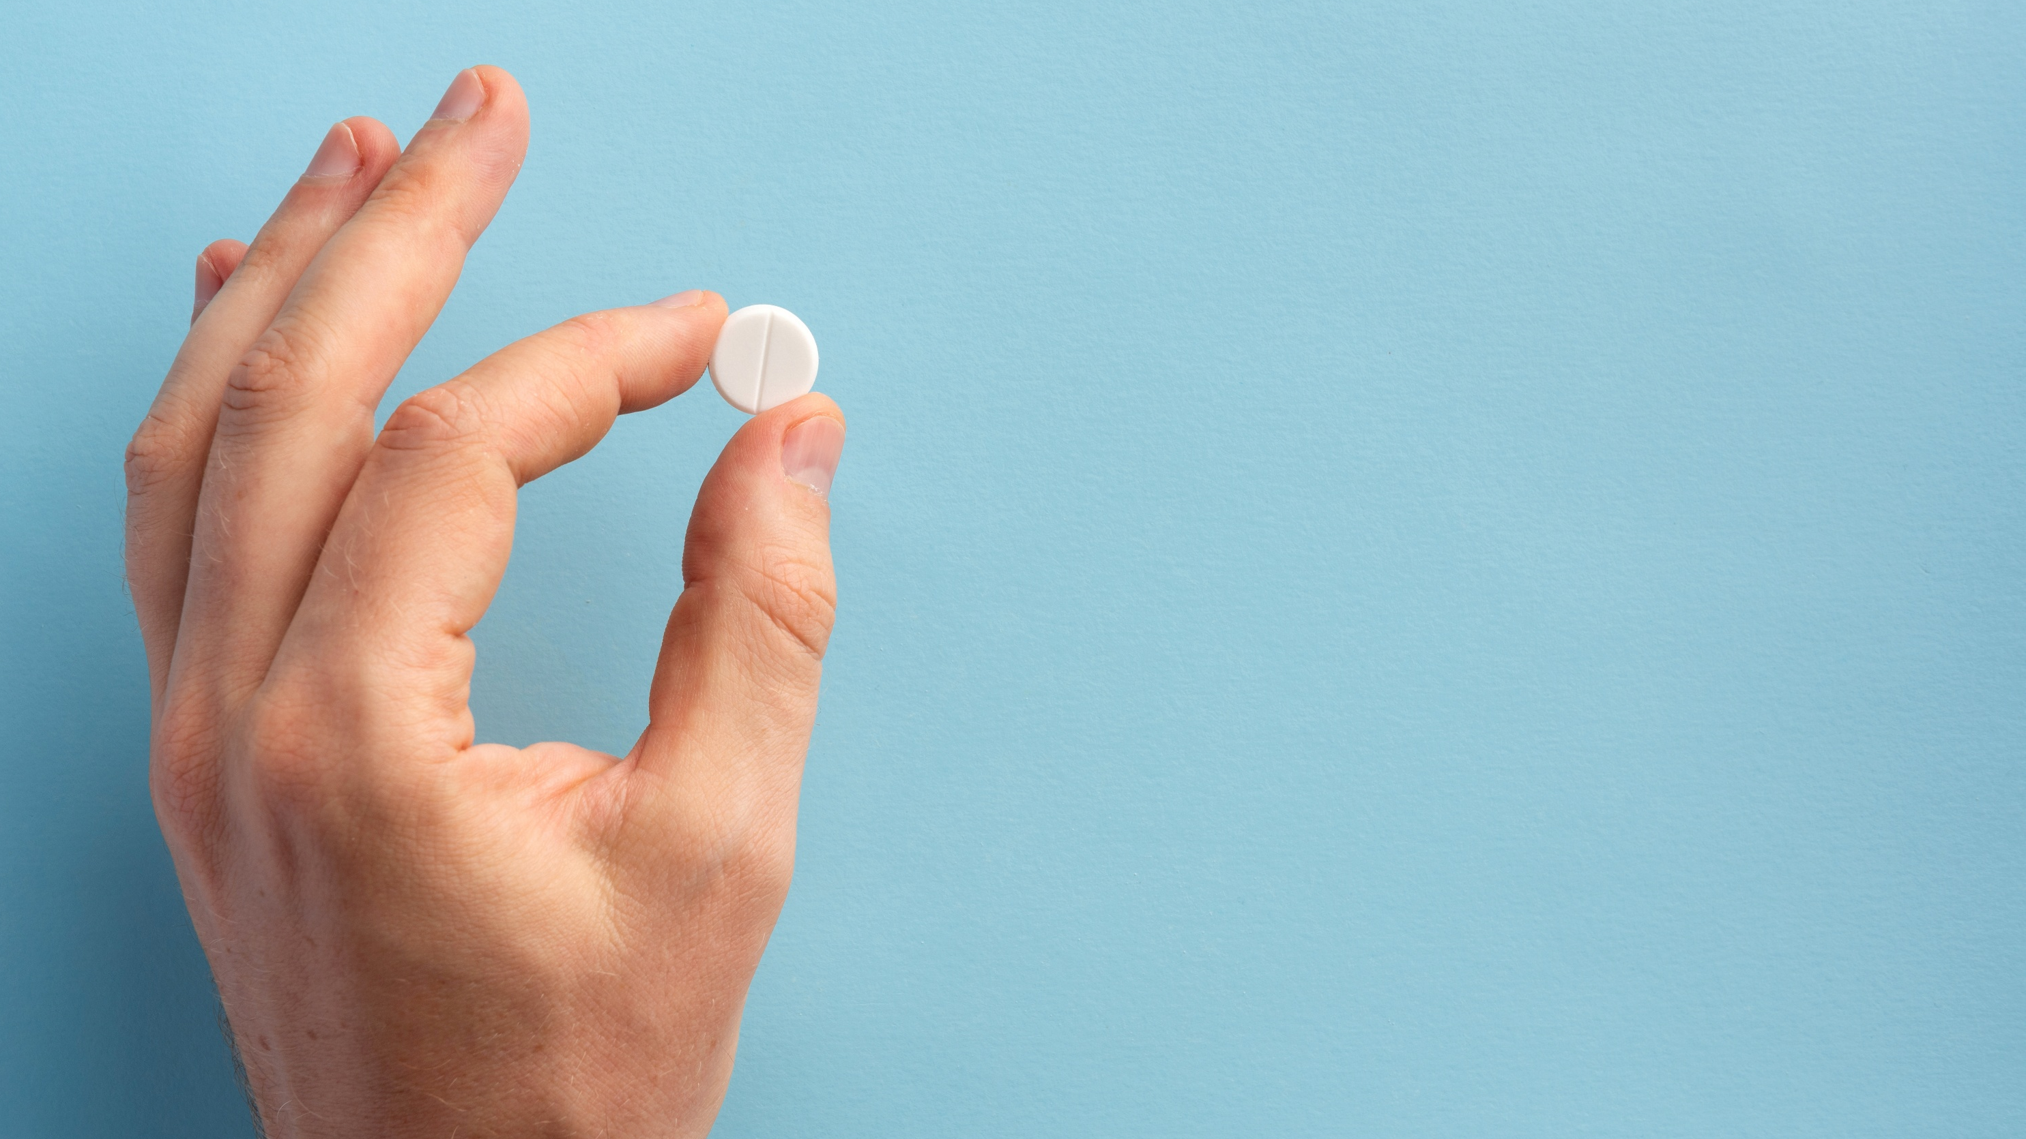
Common Concerns About Fentanyl & Naloxone

Slide 16

Myth #1 Skin exposure to fentanyl can cause an overdose.
Skin exposure to fentanyl poses little risk.
It’s still a good idea to:
Wear gloves.
Wash your hands.
Avoid scratching yourself.

Slide 17
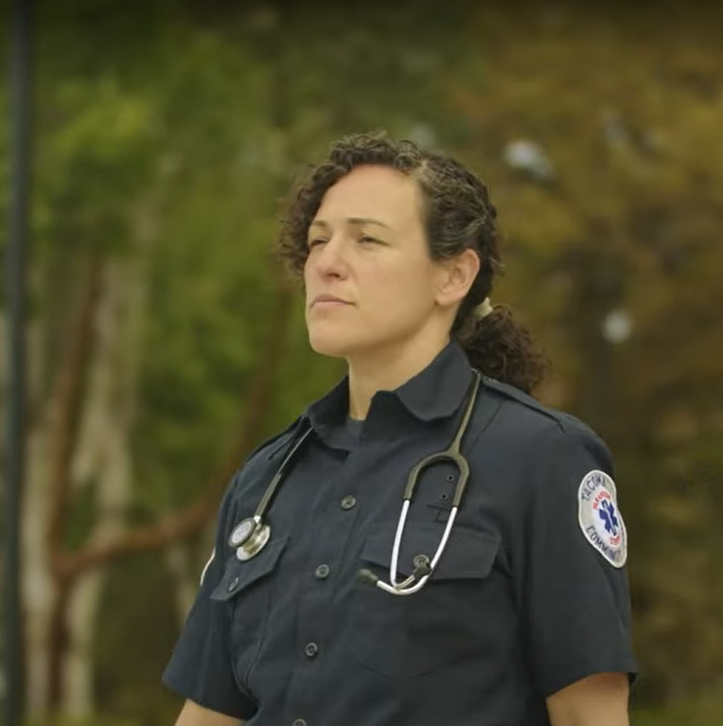
Myth #2 Inhaling fentanyl powder can cause an overdose.
If you inhale fentanyl powder, you will have time to act:
Move to fresh air.
Monitor your symptoms.
Call for help.

Slide 18
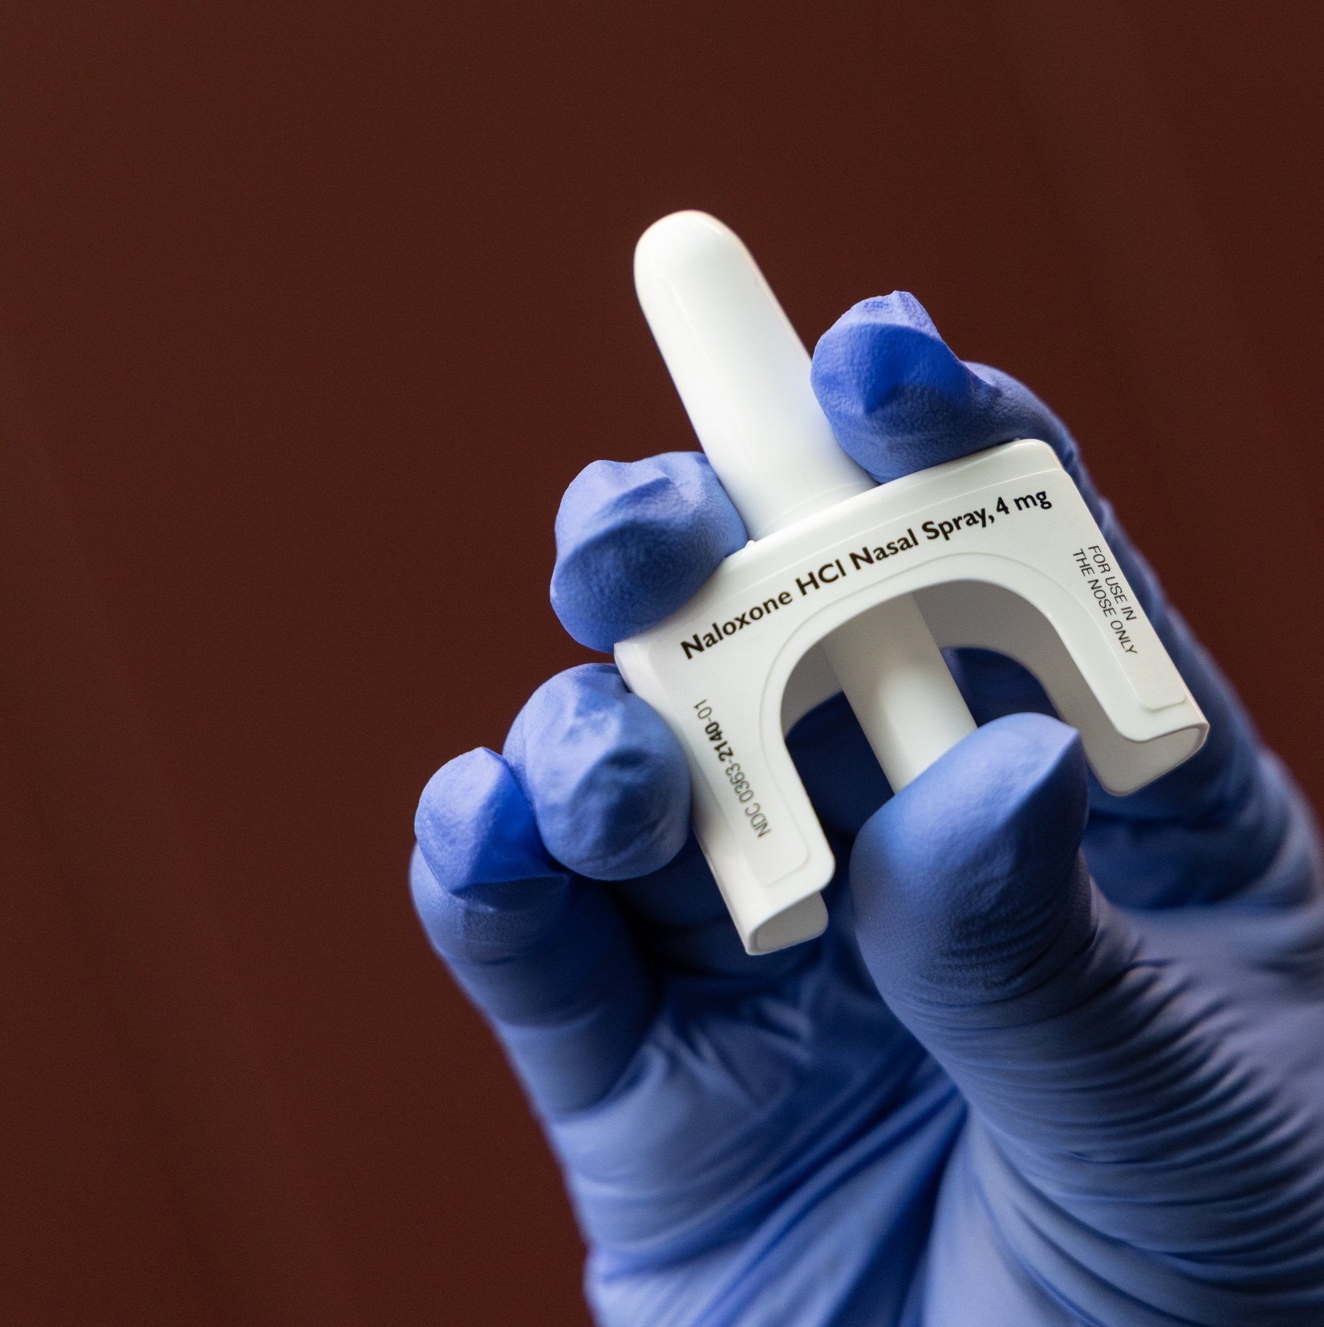
Myth #3 Naloxone can cause an overdose.
Naloxone is safe, so use it if you need it.
It binds with opioids and blocks the effects on your system.
If there are no opioids present, it does nothing.
You can’t overdose on naloxone, and people often need multiple doses.

Slide 19
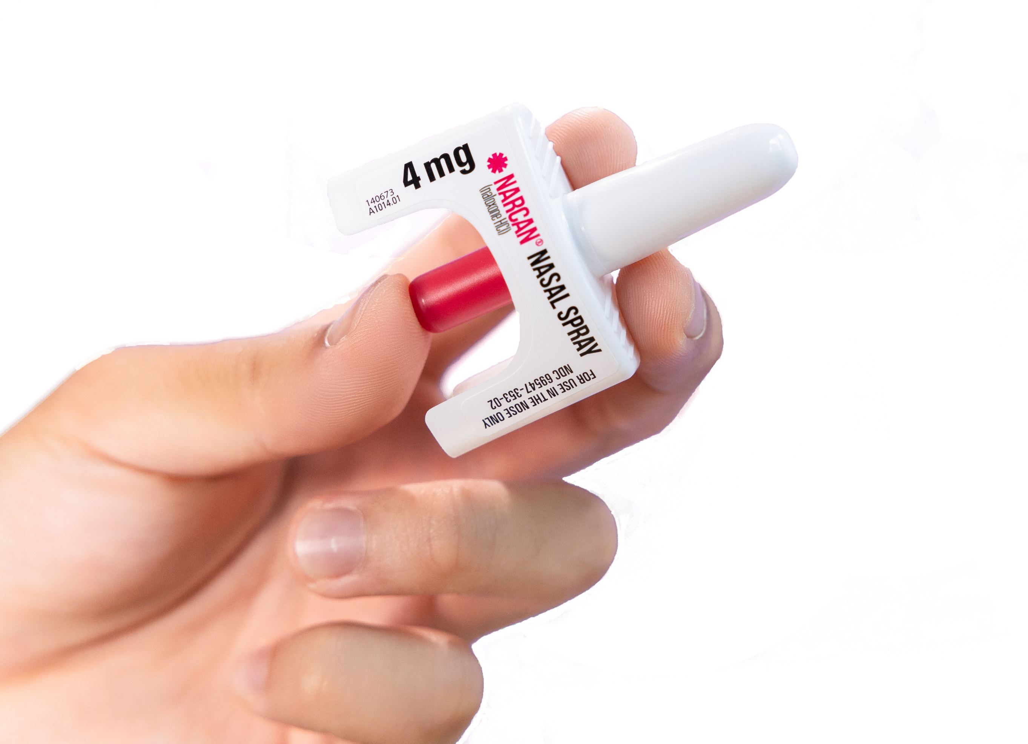
Key Takeaways

Slide 20
Be informed. Be prepared. Be safe.
Fentanyl is a strong opioid, different from other drugs.
Your safety comes first. Wear PPE. Don’t panic.
Skin exposure to fentanyl poses little risk of overdose.
Respond to an overdose quickly. Use naloxone.
Naloxone is safe, even if no opioids are present.
It’s safe to treat an overdose.

Slide 21
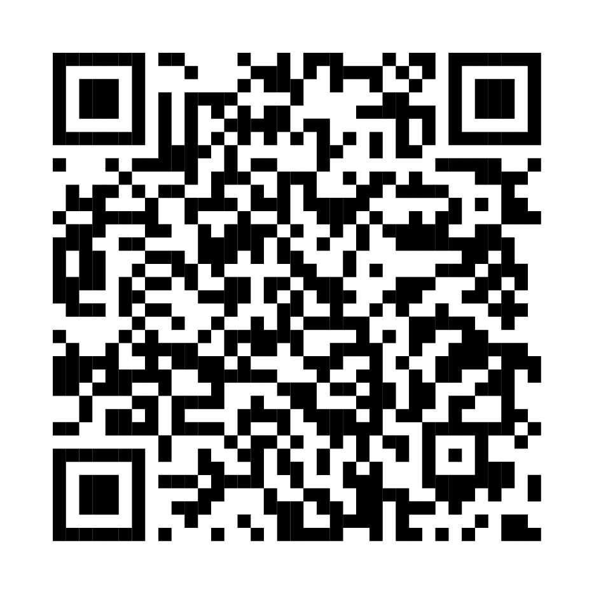
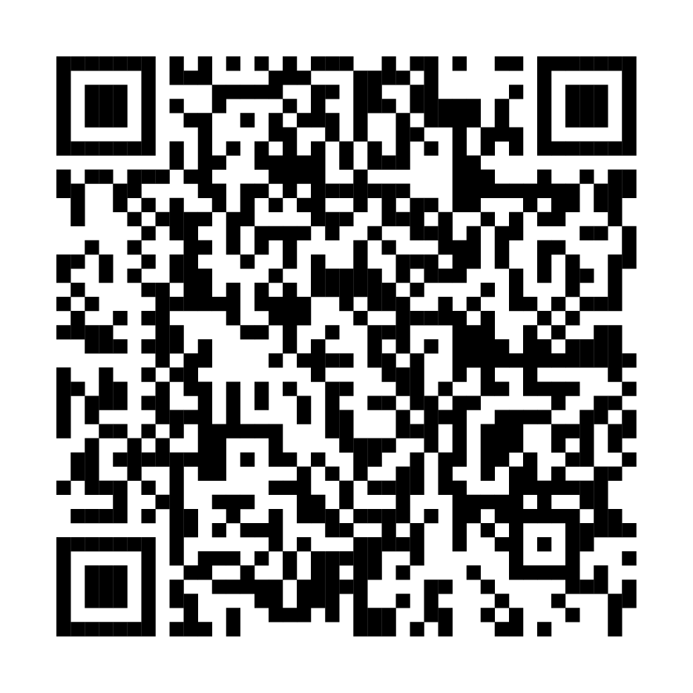
Resources
Find naloxone near you
Overdose education & naloxone distribution
You can get naloxone at most pharmacies without a prescription.
Most insurance covers the cost, or you may be able to get it free from a community organization.
Get helpful resources from Washington State Department of Health.
Get more great resources on fentanyl, overdose prevention, and treatment at fentanylfacts.org

